Slide 1
FuelMart & Subway Safety Committee Meeting
Wednesday, January 22, 2020
2:00 PM Eastern
Corporate Office Conference Room and GoTo Meeting Web Conference

Slide 2
December 2019 Review:
Safety Topic – cold and flu prevention
One employee reported injury
Two submissions for Making Safety a Family Affair awarded 500 FM points each

Slide 3
Incidents and Injuries From 12.16.19 to 1.22.20

Slide 4
Employee Work Related Injuries
Previous Injury: 12.09.19 – Office chair broke. Employee fell to the ground and injured back. Injury resulted in days away from work. OSHA Recordable.
* Reminder to report furniture issues to Todd N. for repairs and/or replace defective furniture but be sure to notify Haley or Joel first.
12.19.19 FM employee unknowingly inhaled/ingested an illegal substance causing dizziness and feeling sick. Employee sought medical treatment. OSHA recordable injury.
12.22.19 FM employee putting deicer down, slipped on the ice and fell hitting their head.
* Reminder when putting salt down, ensure you stay on areas that are already salted for better traction.

Slide 5
Employee Work Related Injuries (c0nt.)
01.10.20 FM employee was bagging a rubber strap and it snapped back striking the employee in the left eye.
01.12.20 Subway employee using knife to open bag of olives and lacerated left index finger.
*knife was closer to the employee, so employee used the knife instead of scissors to open the bag. Scissors are the proper tool to be used to open plastic bags.
01.20.20 FM employee picked up a book from the floor and struck right eye and side of forehead. No injury.

Slide 6
Employee Injuries
12.19.19 FM employee unknowingly absorbed/inhaled/ingested an illegal substance causing dizziness and feeling sick. OSHA recordable injury.
12.22.19 FM employee putting deicer down, slipped on the ice and fell hitting their head.
*As you are putting salt down, ensure you stay on areas that are already salted for better traction.
01.10.20 FM employee was bagging a rubber strap and it snapped back striking the employee in the left eye.
01.12.20 Subway employee using knife to open bag of olives and lacerated left index finger.
*knife was closer to the employee, so employee used the knife instead of scissors to open the bag.

Slide 7
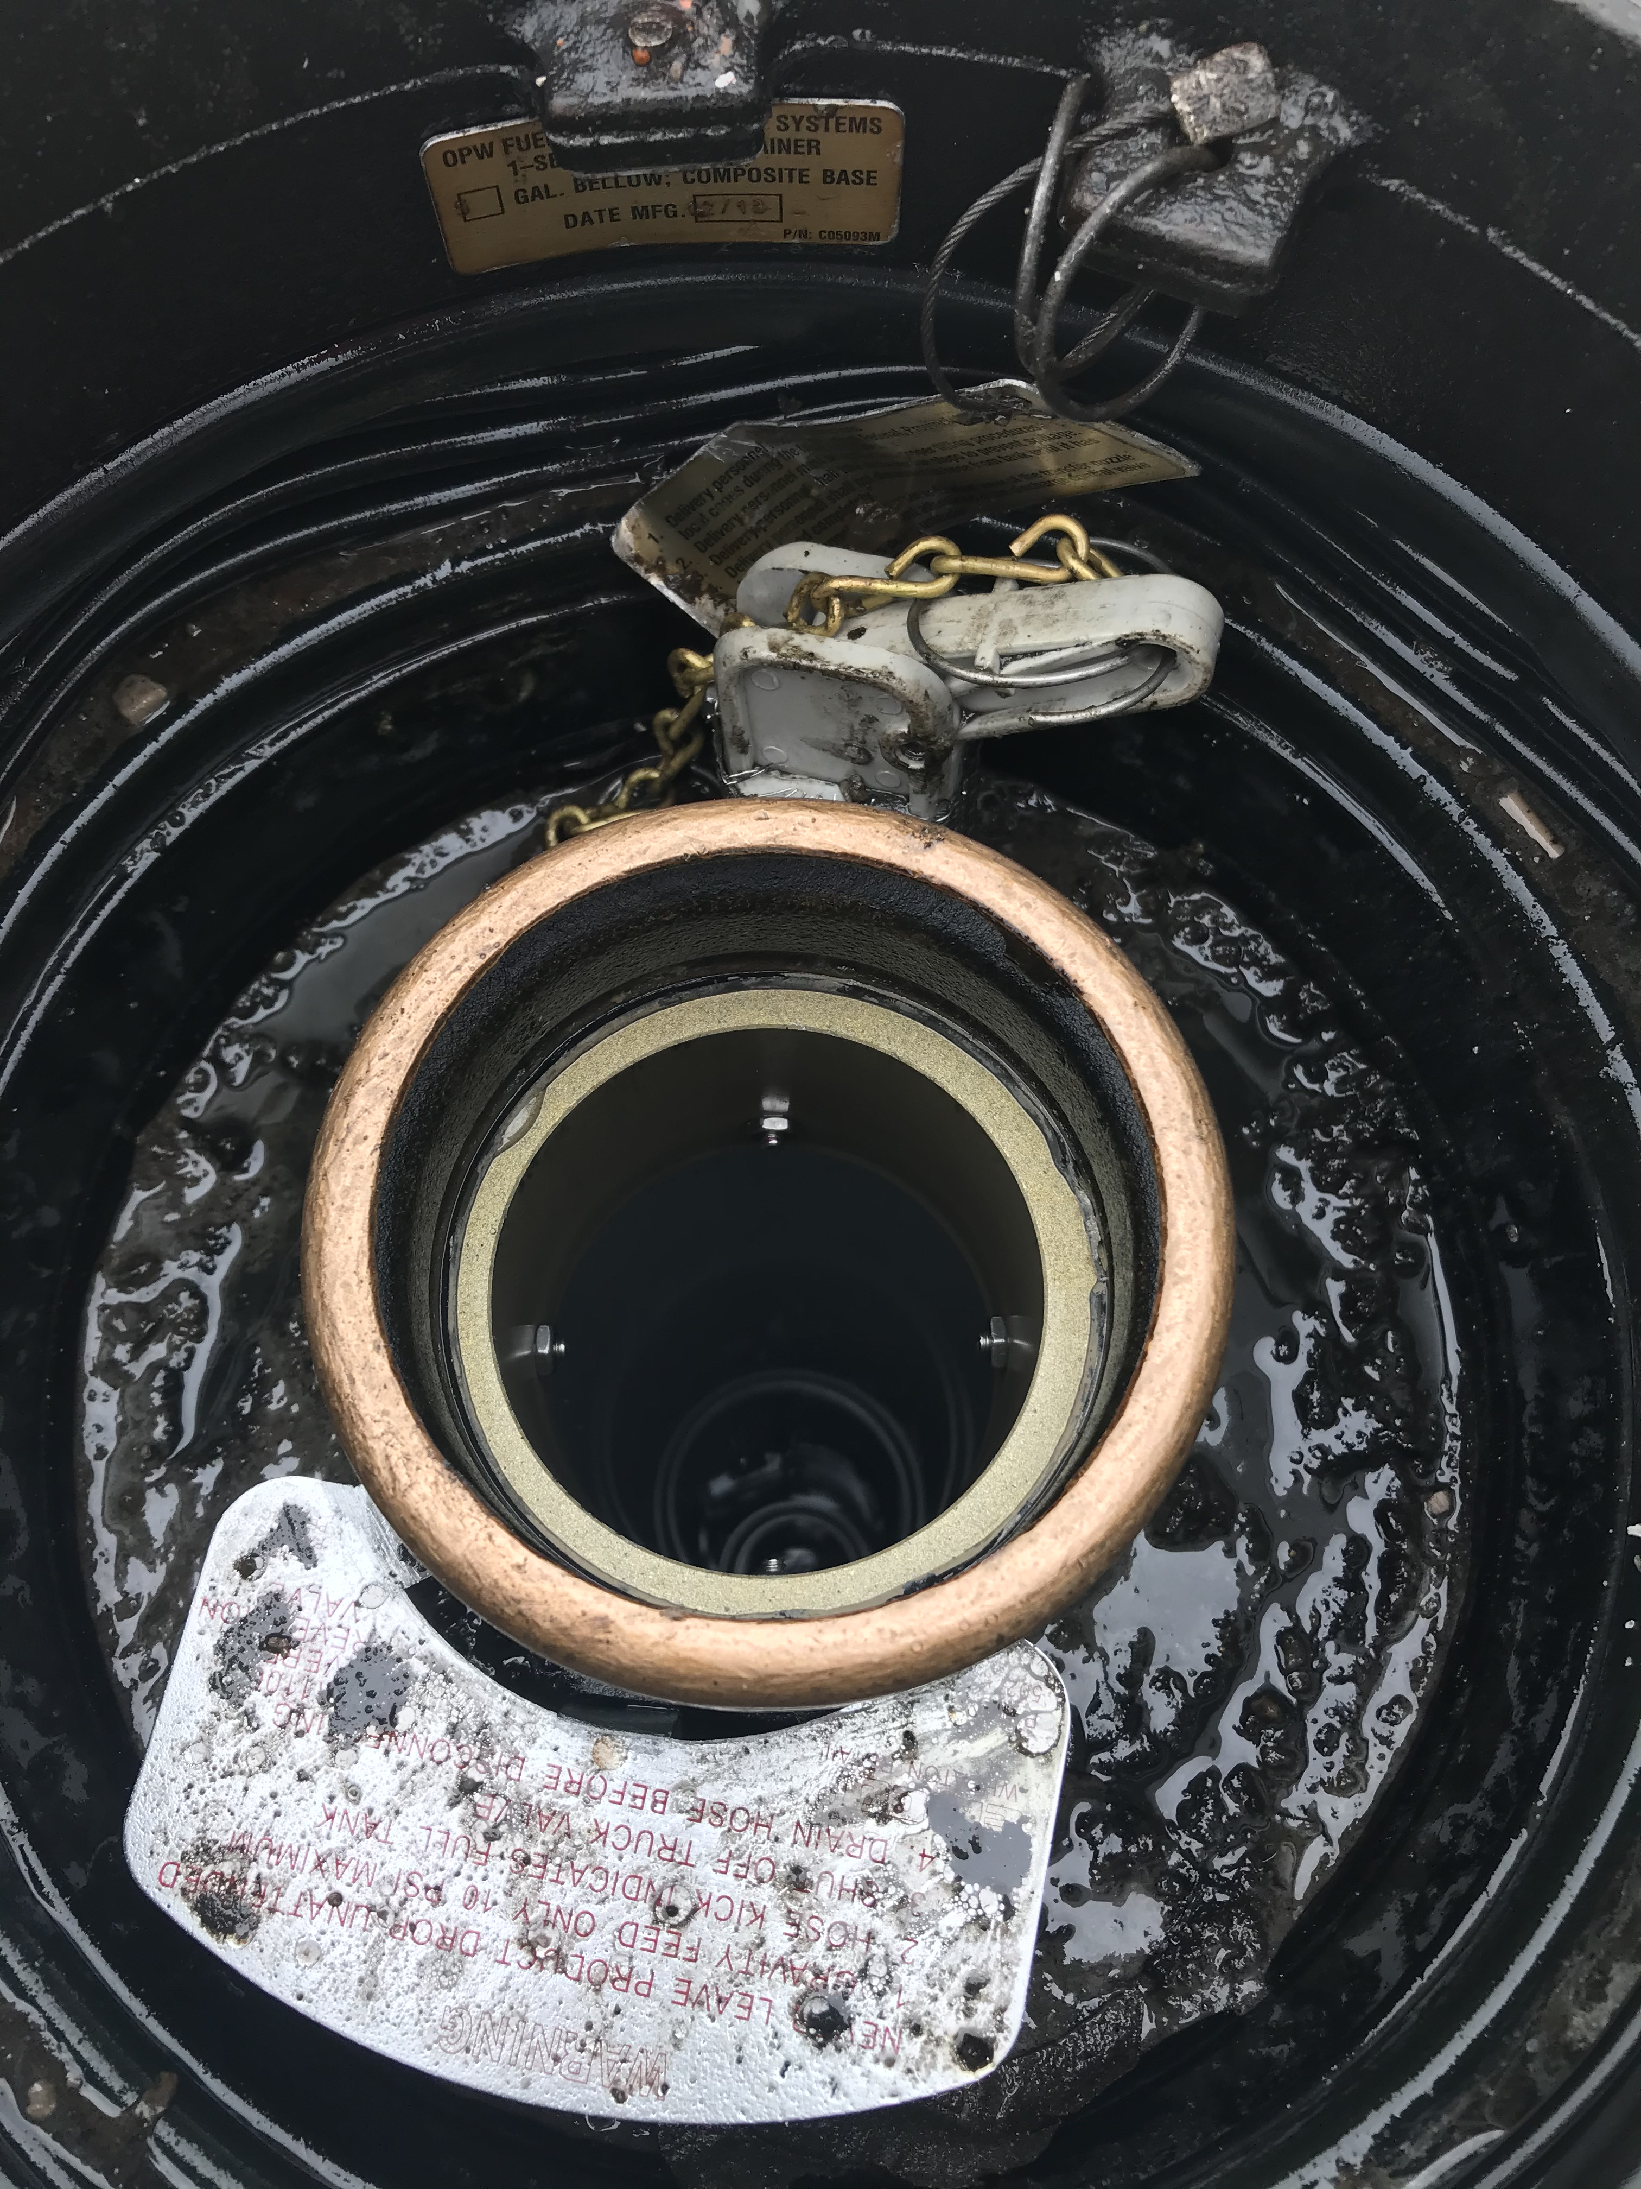
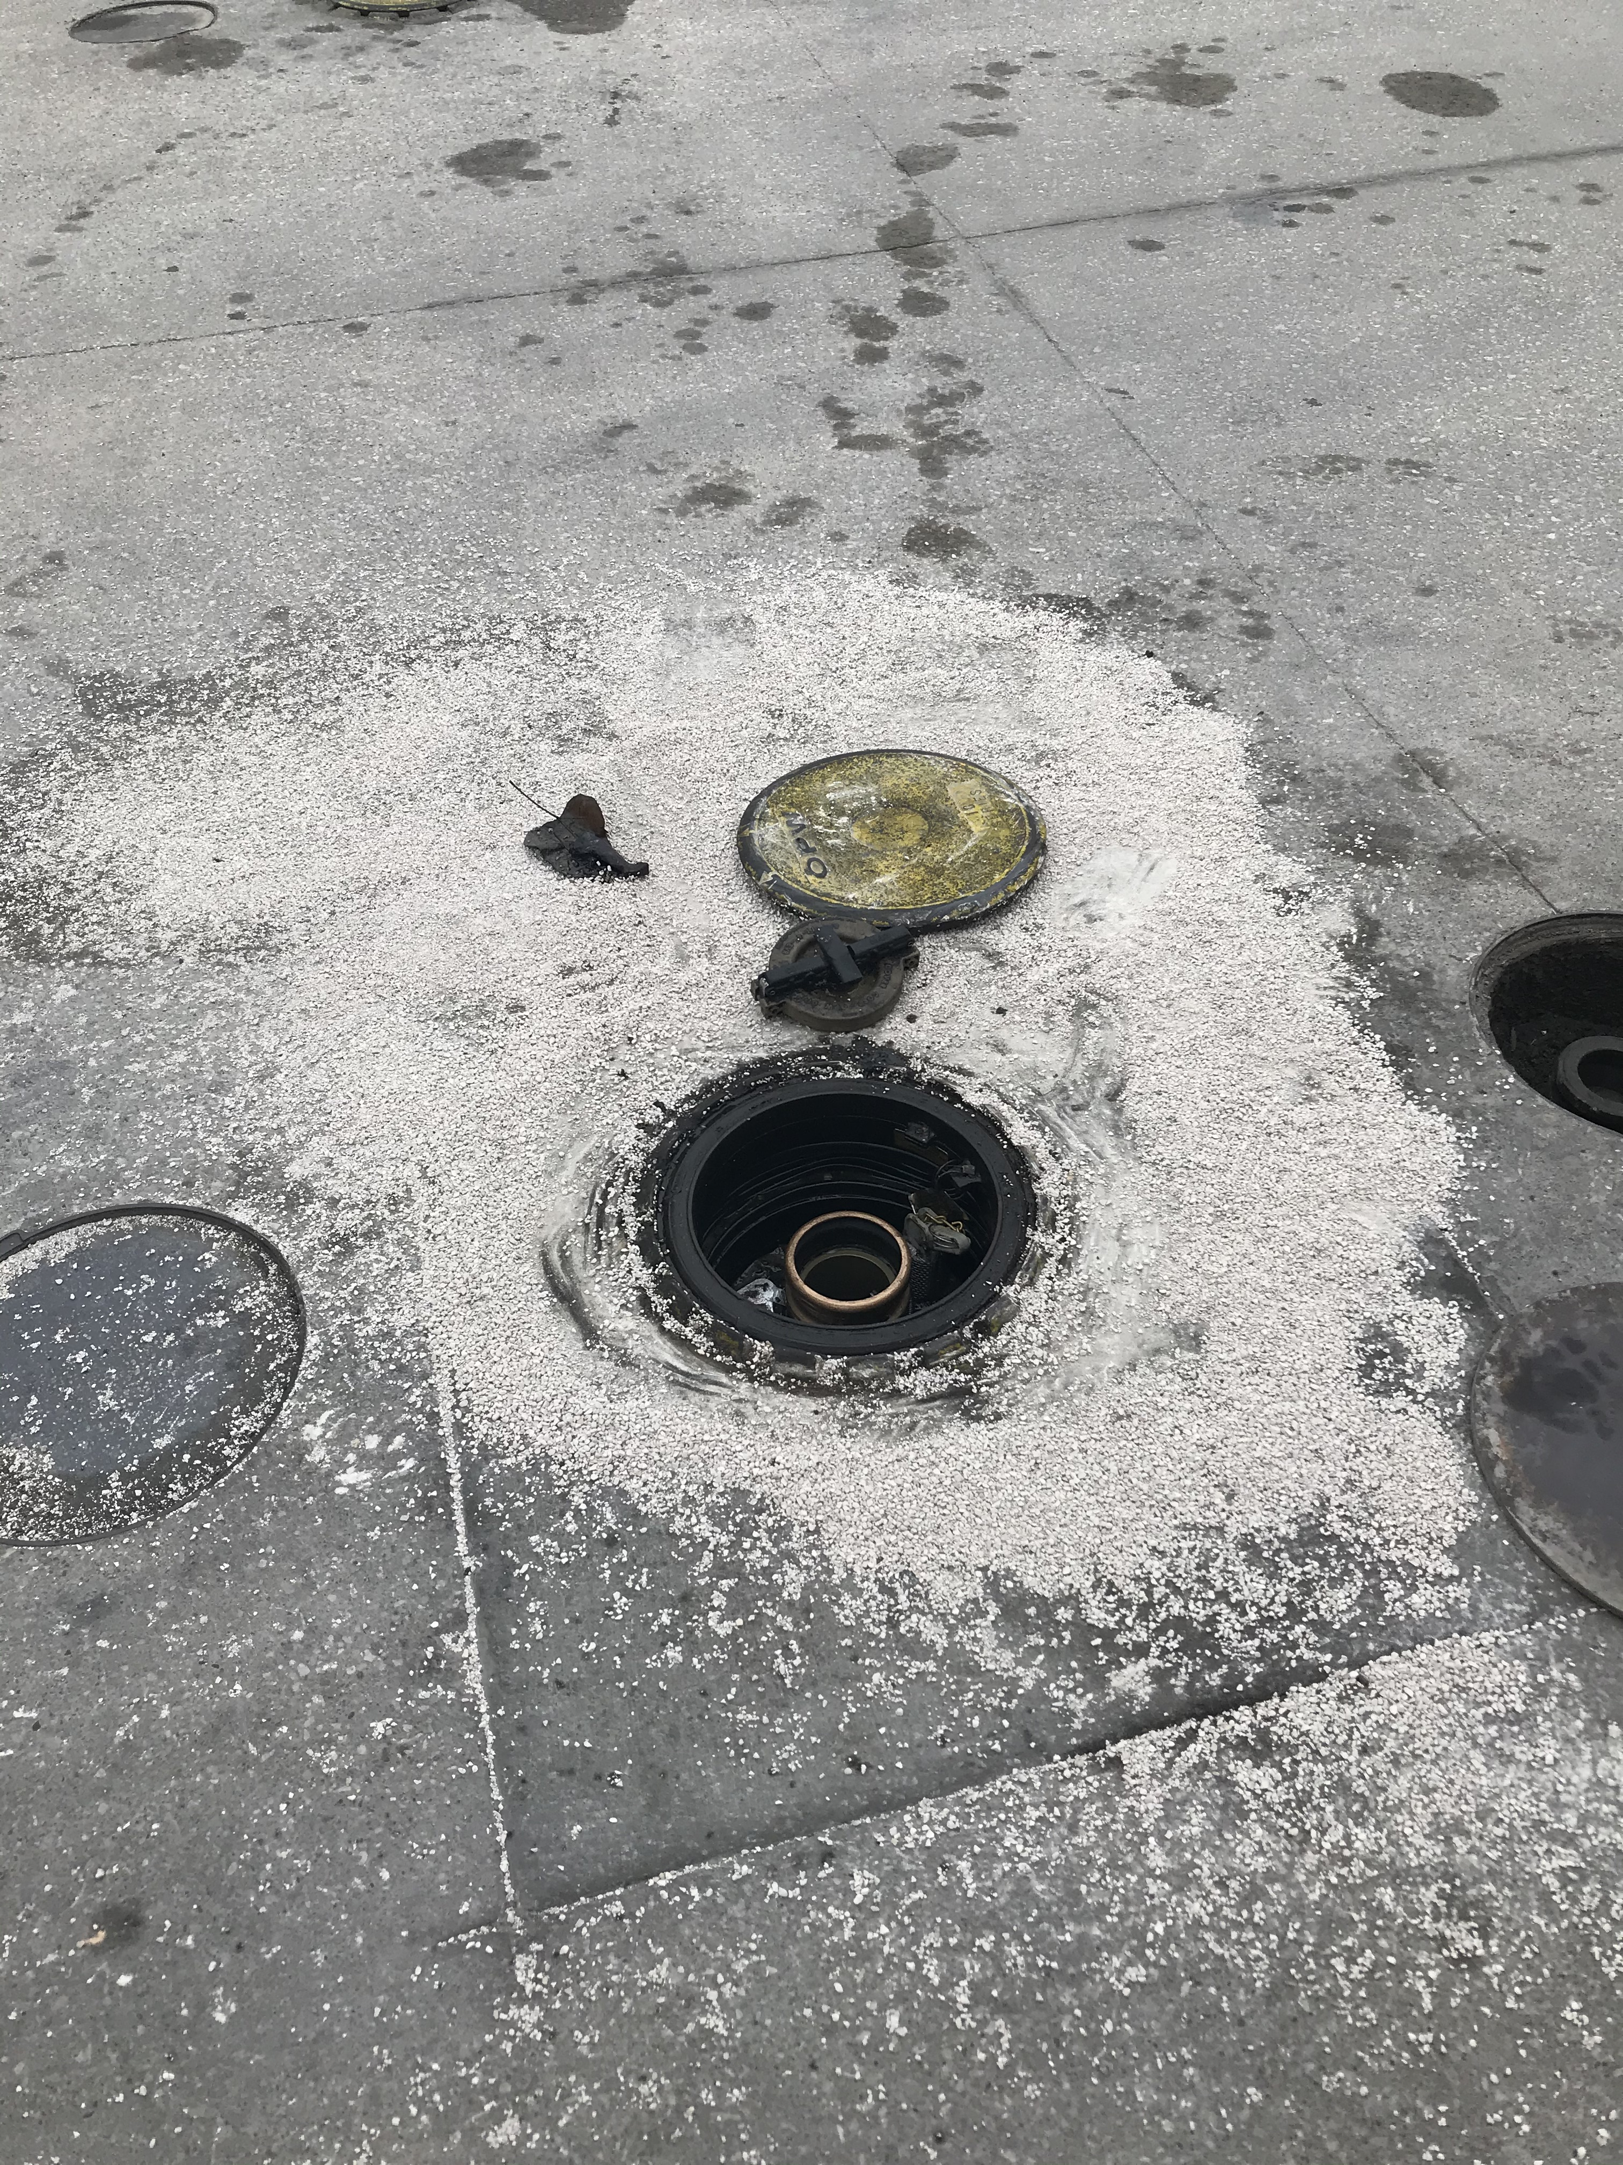
Delivery Diesel Spill
1.02.20 - FM 783 – Ports Petroleum driver identified a minor diesel spill and reported it to Helen. Spill was created by previous fuel delivery driver.

Slide 8
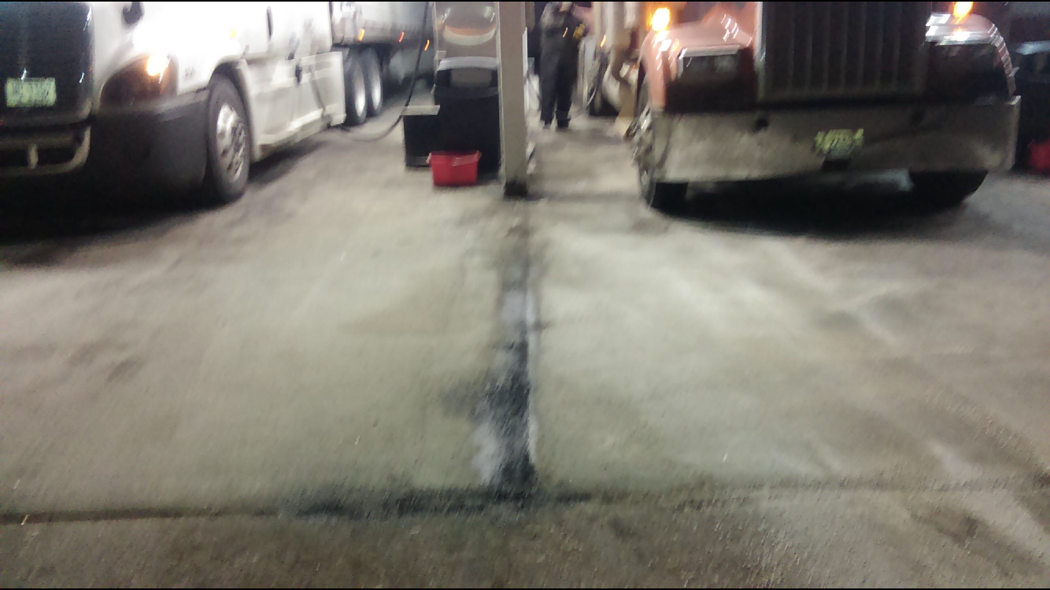
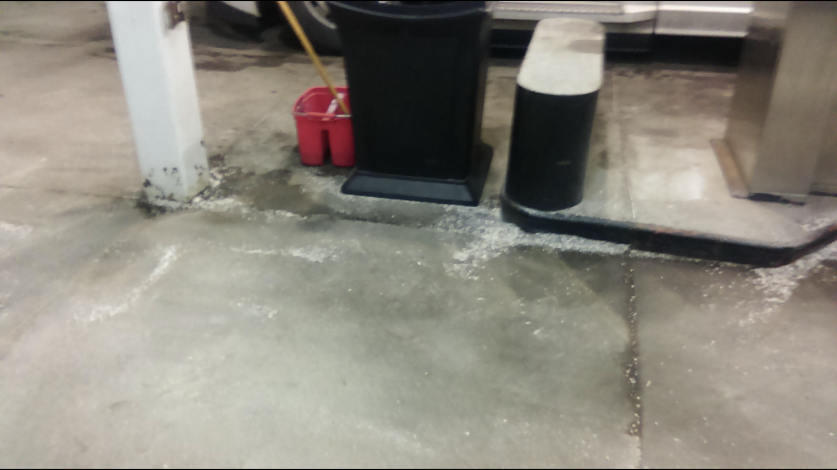
Customer Diesel Spill
1.9.20 FM 645 customer using the satellite nozzle at diesel pump 8 overfilled their semi saddle tank and approximately 5 gallons was spilled onto the concrete. FM was able to clean it up. The customer said the nozzle did not shut off. The next customer had no issues with the satellite nozzle shutting off. The nozzle was not taken out of service.

Slide 9
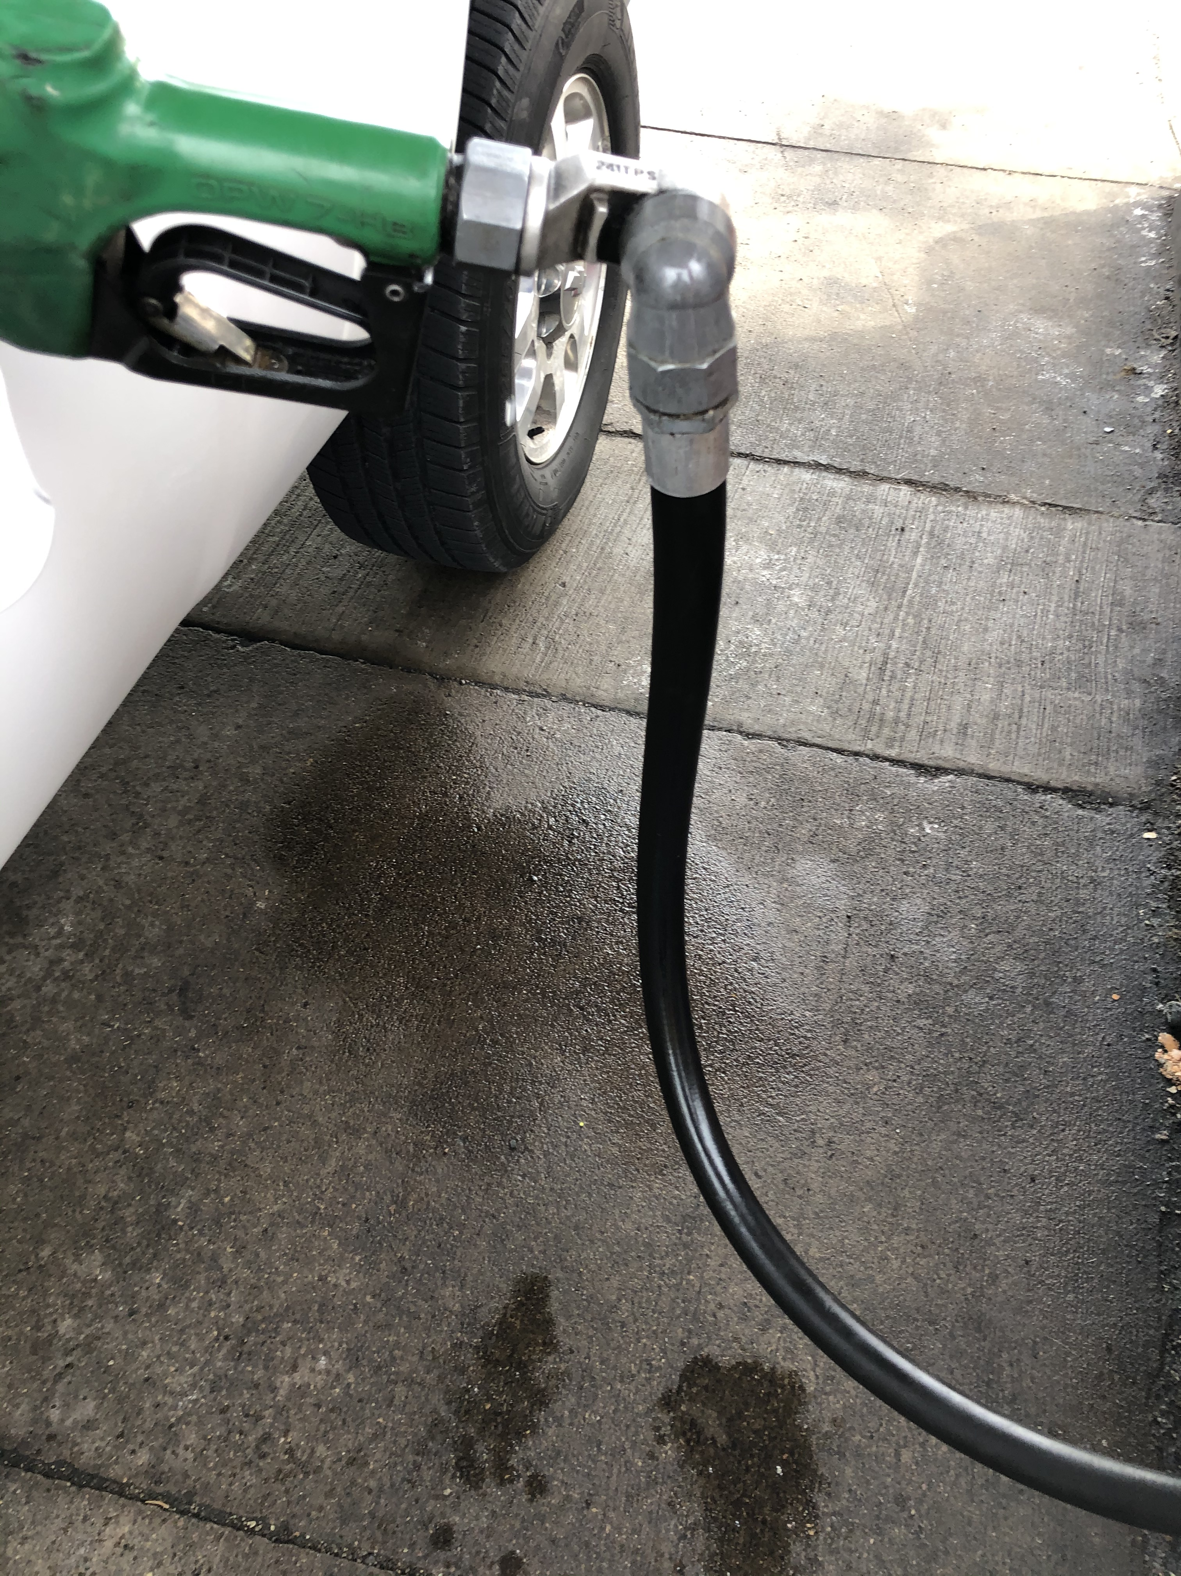
Customer Diesel Spill
1.9.20 - FM 641- Ports Petroleum fleet manager had a minor diesel spill at pump 13. The nozzle was leaking when he was filling up the shop pickup truck. He indicated the nozzle is leaking where the hose screws into the nozzle. He informed FM employees of the nozzle issue. FM fixed the issue.

Slide 10
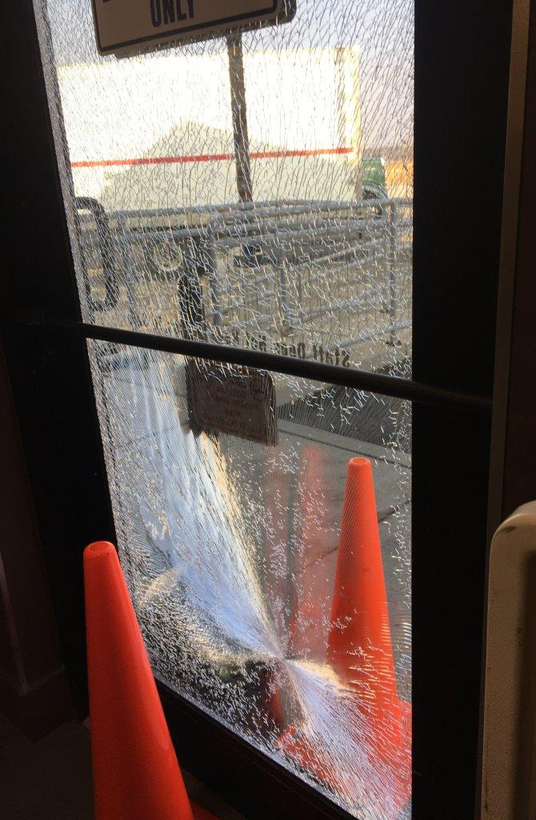
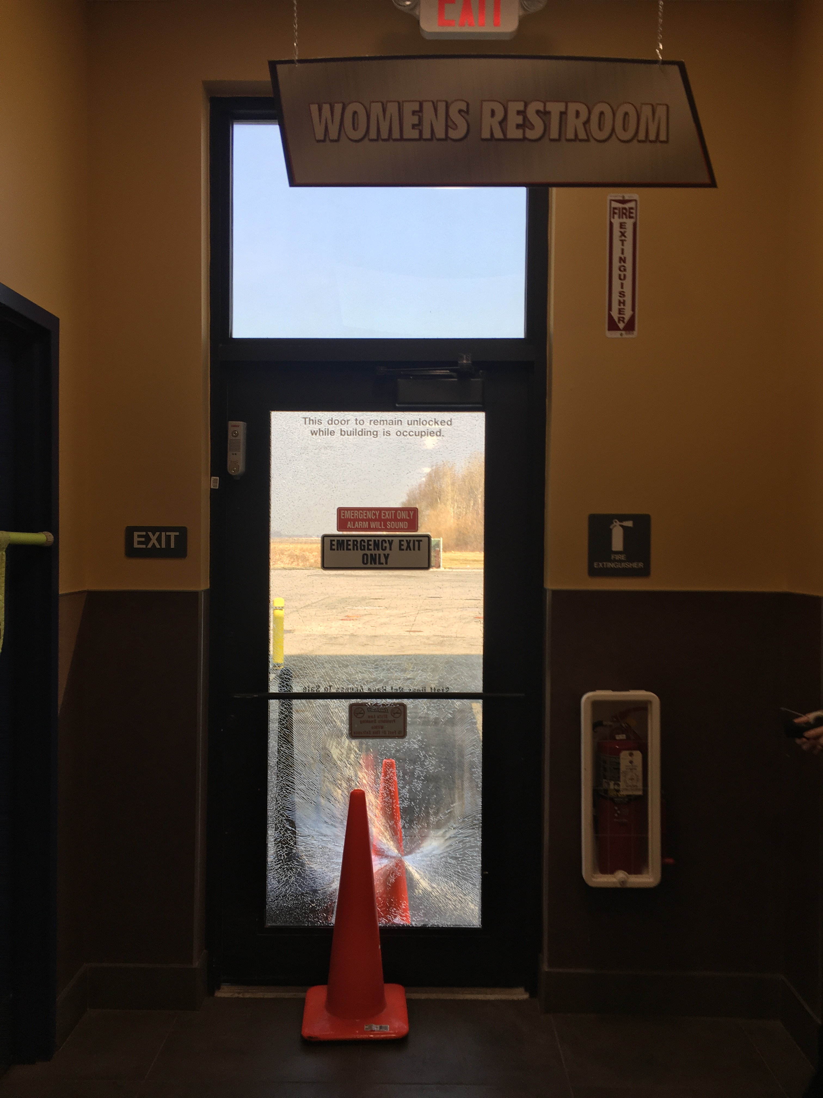
FM Property Damage
1.14.20 - FM 767 - an Eby-Brown delivery person used his cart to open the emergency exit door (delivery door) by the women's restroom and the glass splintered.

Slide 11
Customer Health Issue
1.15.20 - FM 767 – Individual in their vehicle on FM property suffered a heart attack and was transferred to the hospital via ambulance.

Slide 12
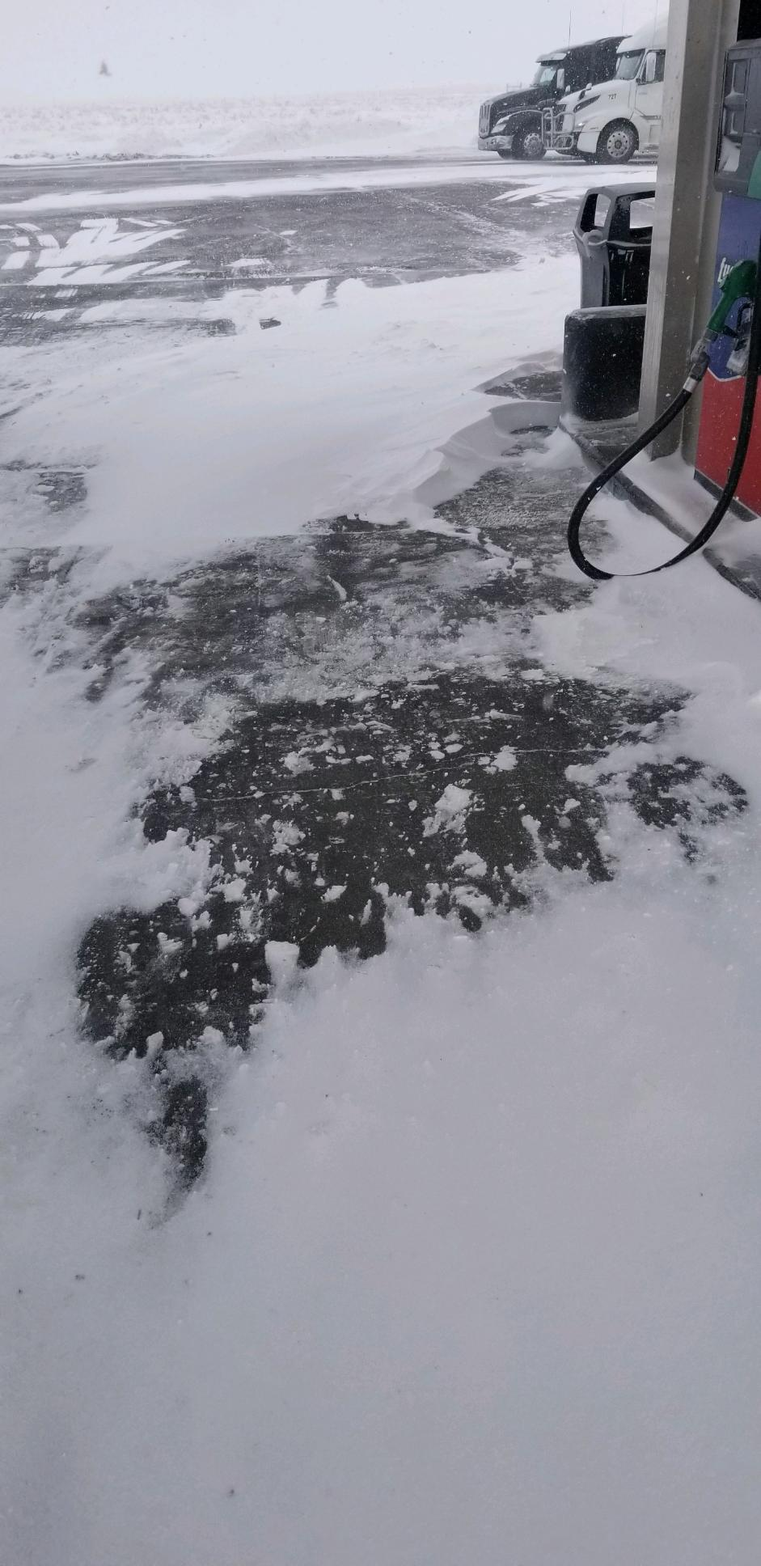
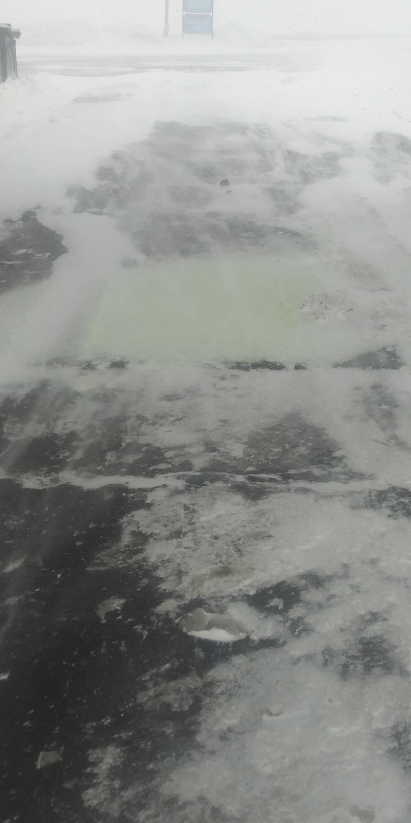
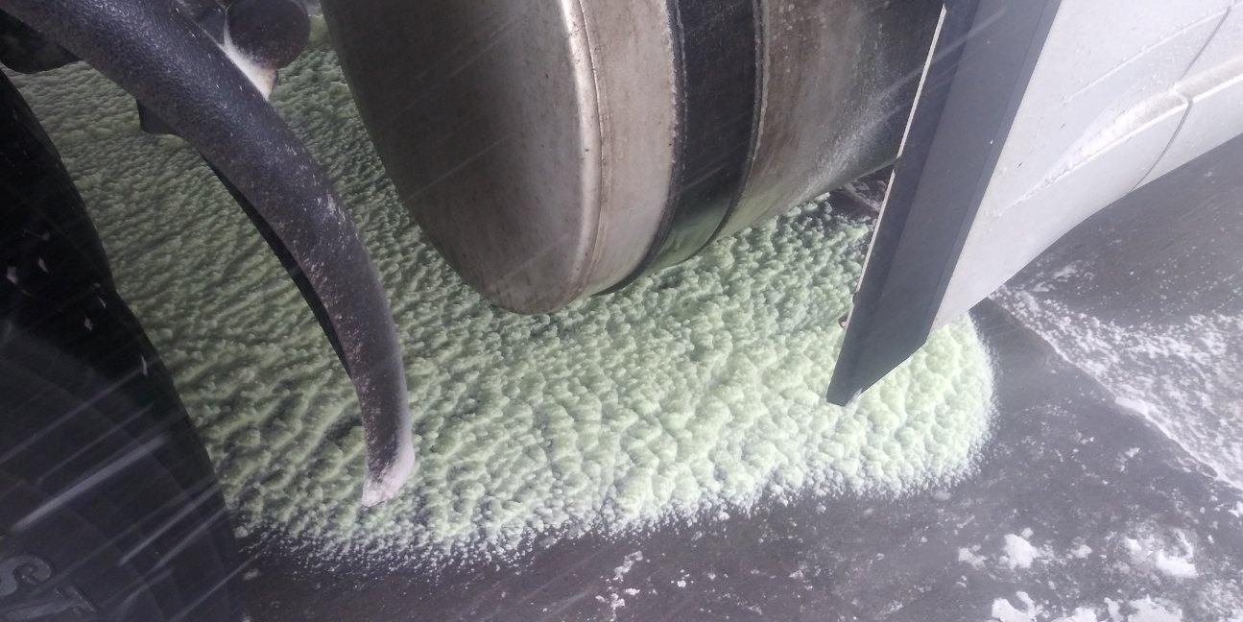
Customer Diesel Spill
1.17.20 - FM 645 - Approx. 7 gallon diesel spill. Fuel soaked into the snow and/or went into oil/ water separator. Driver was sitting inside the semi cab when the satellite side did not click off. The driver said our pumps are too slow and he can’t stand outside that long in the cold weather. Tabitha reminded the driver of proper fueling procedures. Due to the cold weather the FM employees took turns with the cleanup. Nozzle was not replaced or repaired.

Slide 13
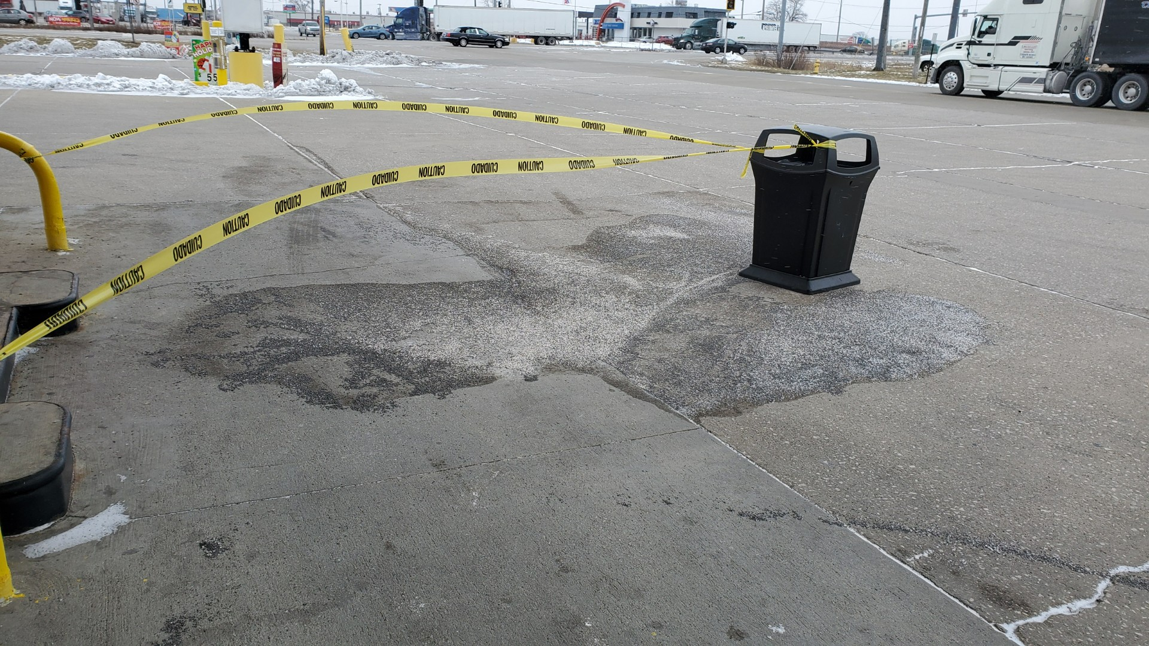
Customer Gasoline Spill
1.19.20 FM 641customer had an approximate 2 gallon gasoline spill at pump 12. The nozzle did not click off. FM employee William is cleaning the spill. At this time we do not know if there is an issue with the nozzle.

Slide 14
Incidents:
1.9.20 FM 645 customer using the satellite nozzle at diesel pump 8 overfilled their semi saddle tank and approximately 5 gallons was spilled onto the concrete. FM was able to clean it up. The customer said the nozzle did not shut off. The next customer had no issues with the satellite nozzle shutting off. The nozzle was not taken out of service.
1.14.20 FM 767 ) at approximately 10:58 am an Eby-Brown delivery person used his cart to open the emergency exit door (delivery door) by the women's restroom and the glass splintered.
1.17.20 FM 767 Customer suffered a heart attack, was transferred to hospital via ambulance.
1.17.20 FM 645 customer spill. Approximately 7 gallons of diesel. Spill cleanup has been completed. Most of the fuel soaked into the snow and/or went into oil, water separator. Impacted area was very small. The driver was sitting inside the semi cab when the satellite side did not click off. Tabitha said the nozzle does not need to be repaired or replaced. The driver said our pumps are too slow and he can’t stand outside that long in the cold weather. Tabitha reminded the driver of proper fueling procedures. Due to the cold weather the FM employees took turns with the cleanup.
1.19.20 FM 641customer had an approximate 2 gallon gasoline spill at pump 12. The nozzle did not click off. FM employee William is cleaning the spill. At this time we do not know if there is an issue with the nozzle.

Slide 15
Date Range: Jan. 01, 2019 – Dec. 31, 2019 Company Total Incidents: 186 FuelMart & Subway Total Incidents: 84 FuelMart & Subway employee injuries Reported: 20 FuelMart Property Damage and/or Vehicle Incidents: 24 FuelMart Customer Spills: 14 (10 spills at fuel pumps) FuelMart & Subway Customer injuries reported: 20 Other Incidents: 6

Slide 16
Date Range: Jan. 01, 2020 – Jan. 22, 2020 Company Total Incidents: 15 FuelMart & Subway Total Incidents: 10 FuelMart & Subway employee injuries Reported: 3 FuelMart Property Damage and/or Vehicle Incidents: 1 FuelMart Customer Spills: 5 (4 spills at fuel pumps) FuelMart & Subway Customer injuries reported: 0 Other Incidents: 1 (heart attack)

Slide 17
Safety Topic – Incident training

Slide 18
What to do in the event of an employee work related injury.

Slide 19
Ohio & Non oHio Injury Sleeve Packets

Slide 20
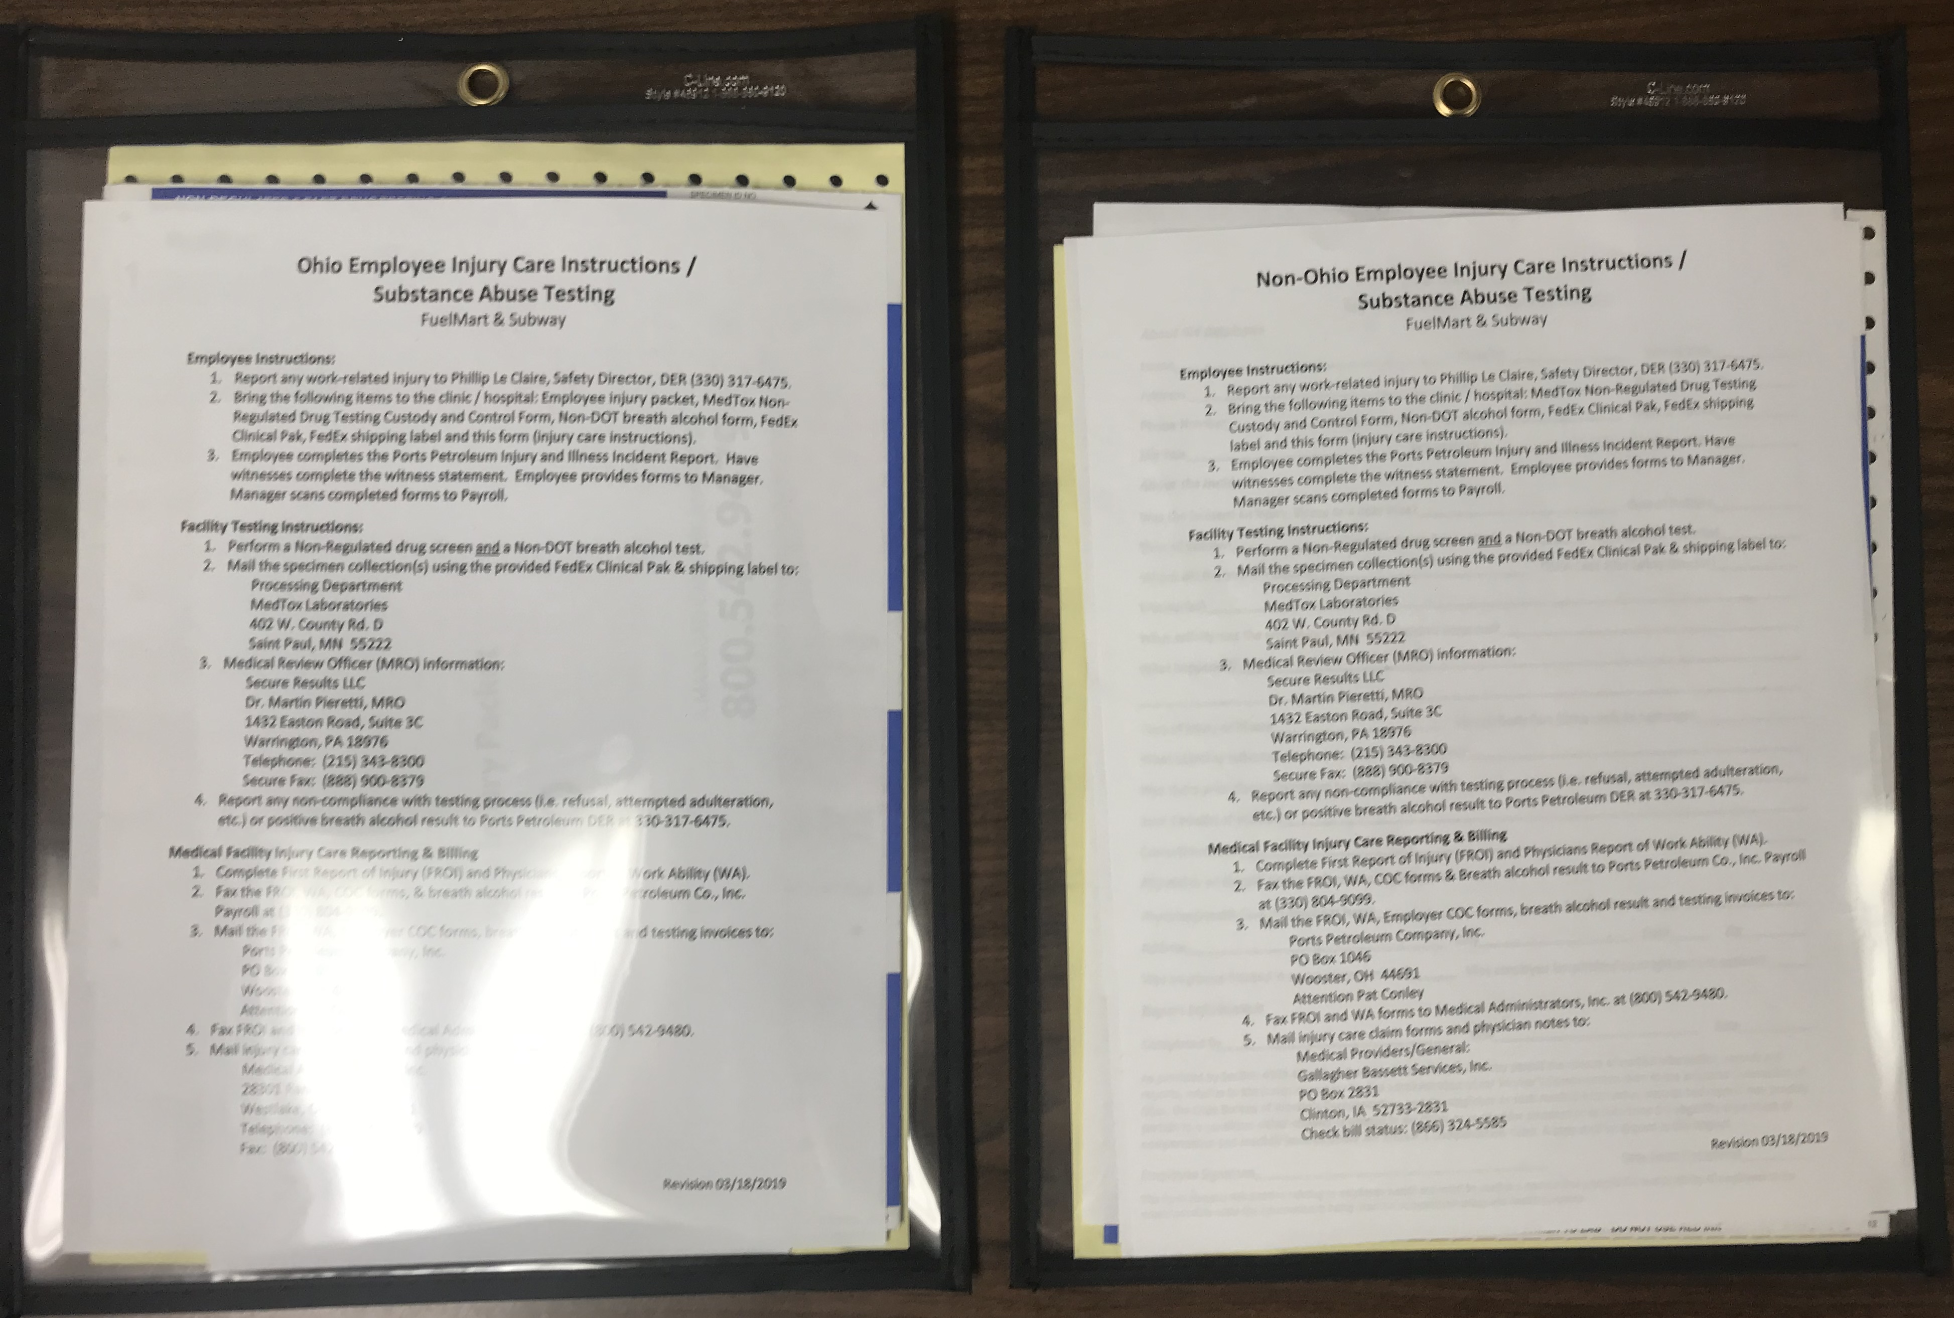

Slide 21
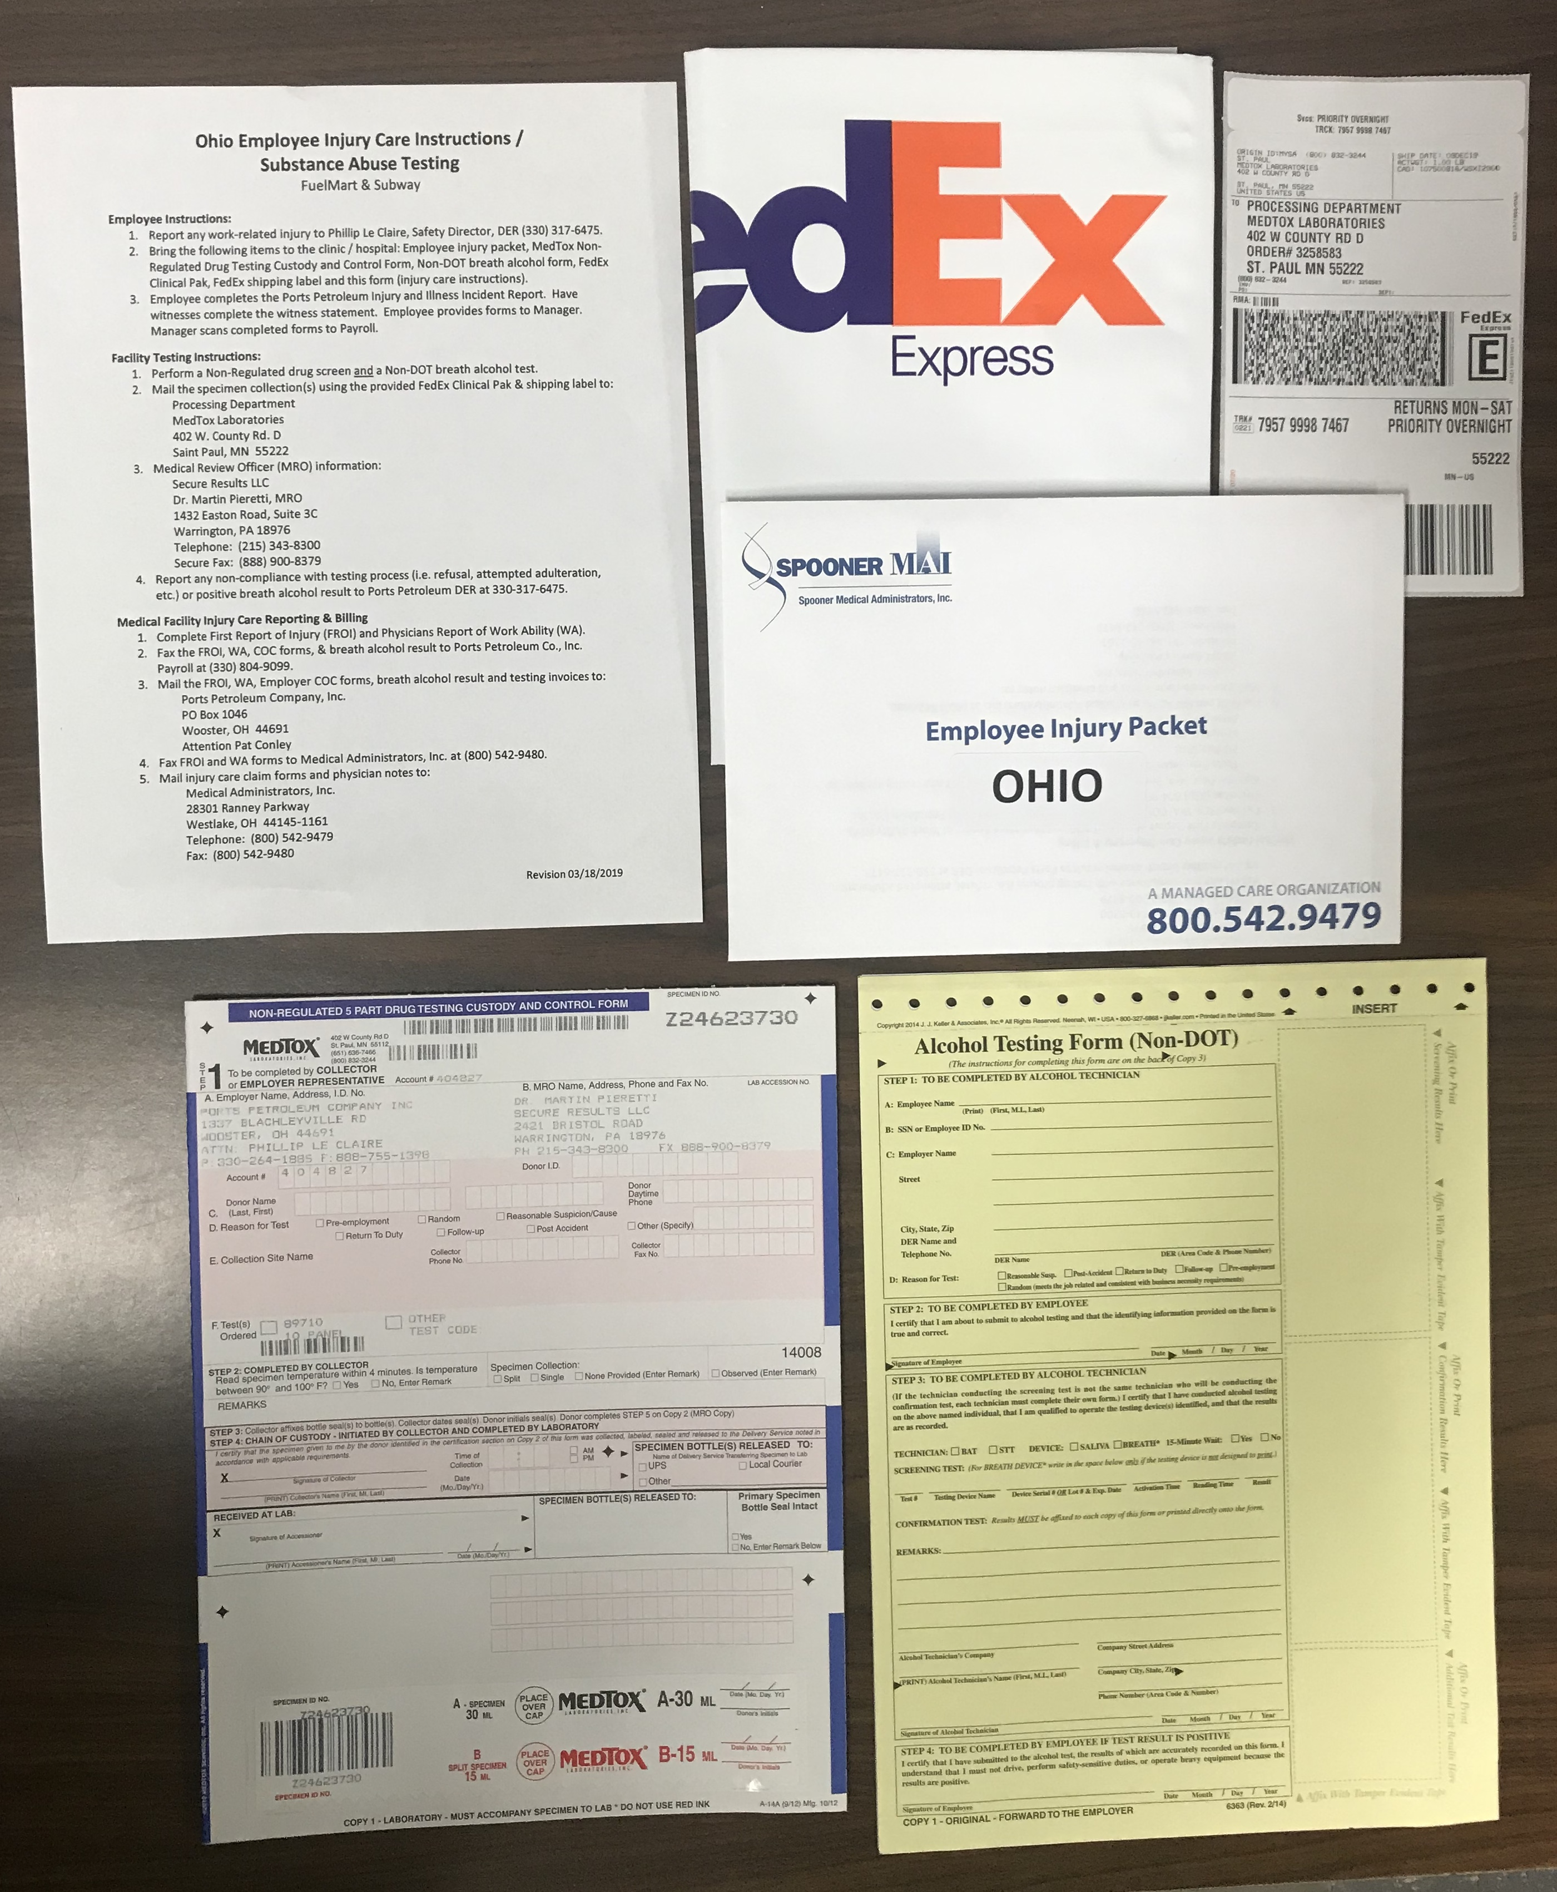
Ohio Injury Packet Contents
Revision 3.18.19

Slide 22
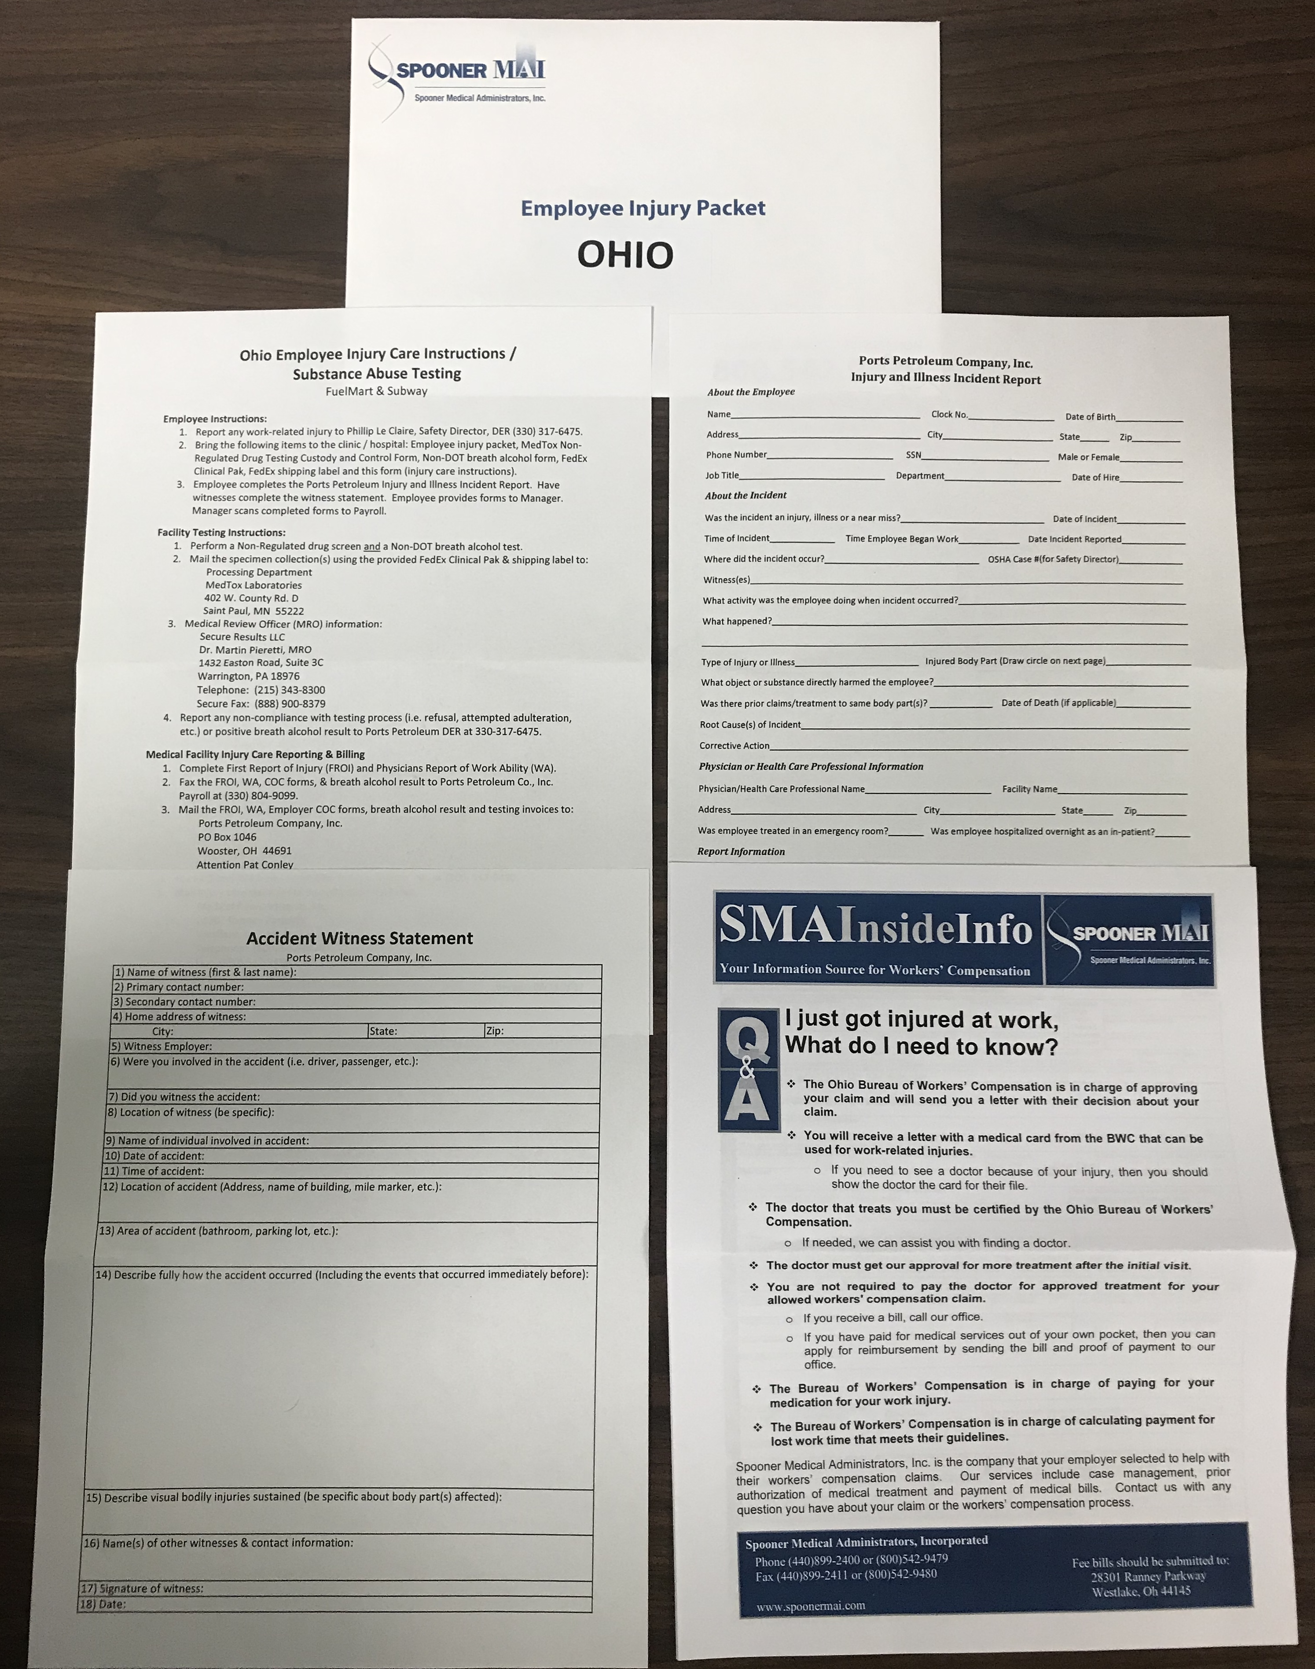
Ohio Injury Packet Contents (Cont.)

Slide 23
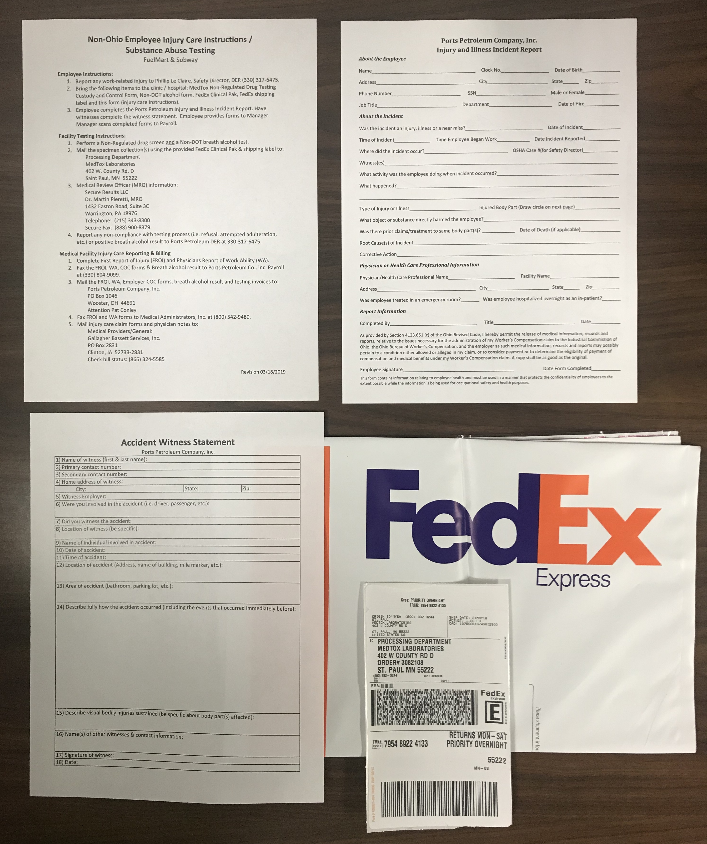
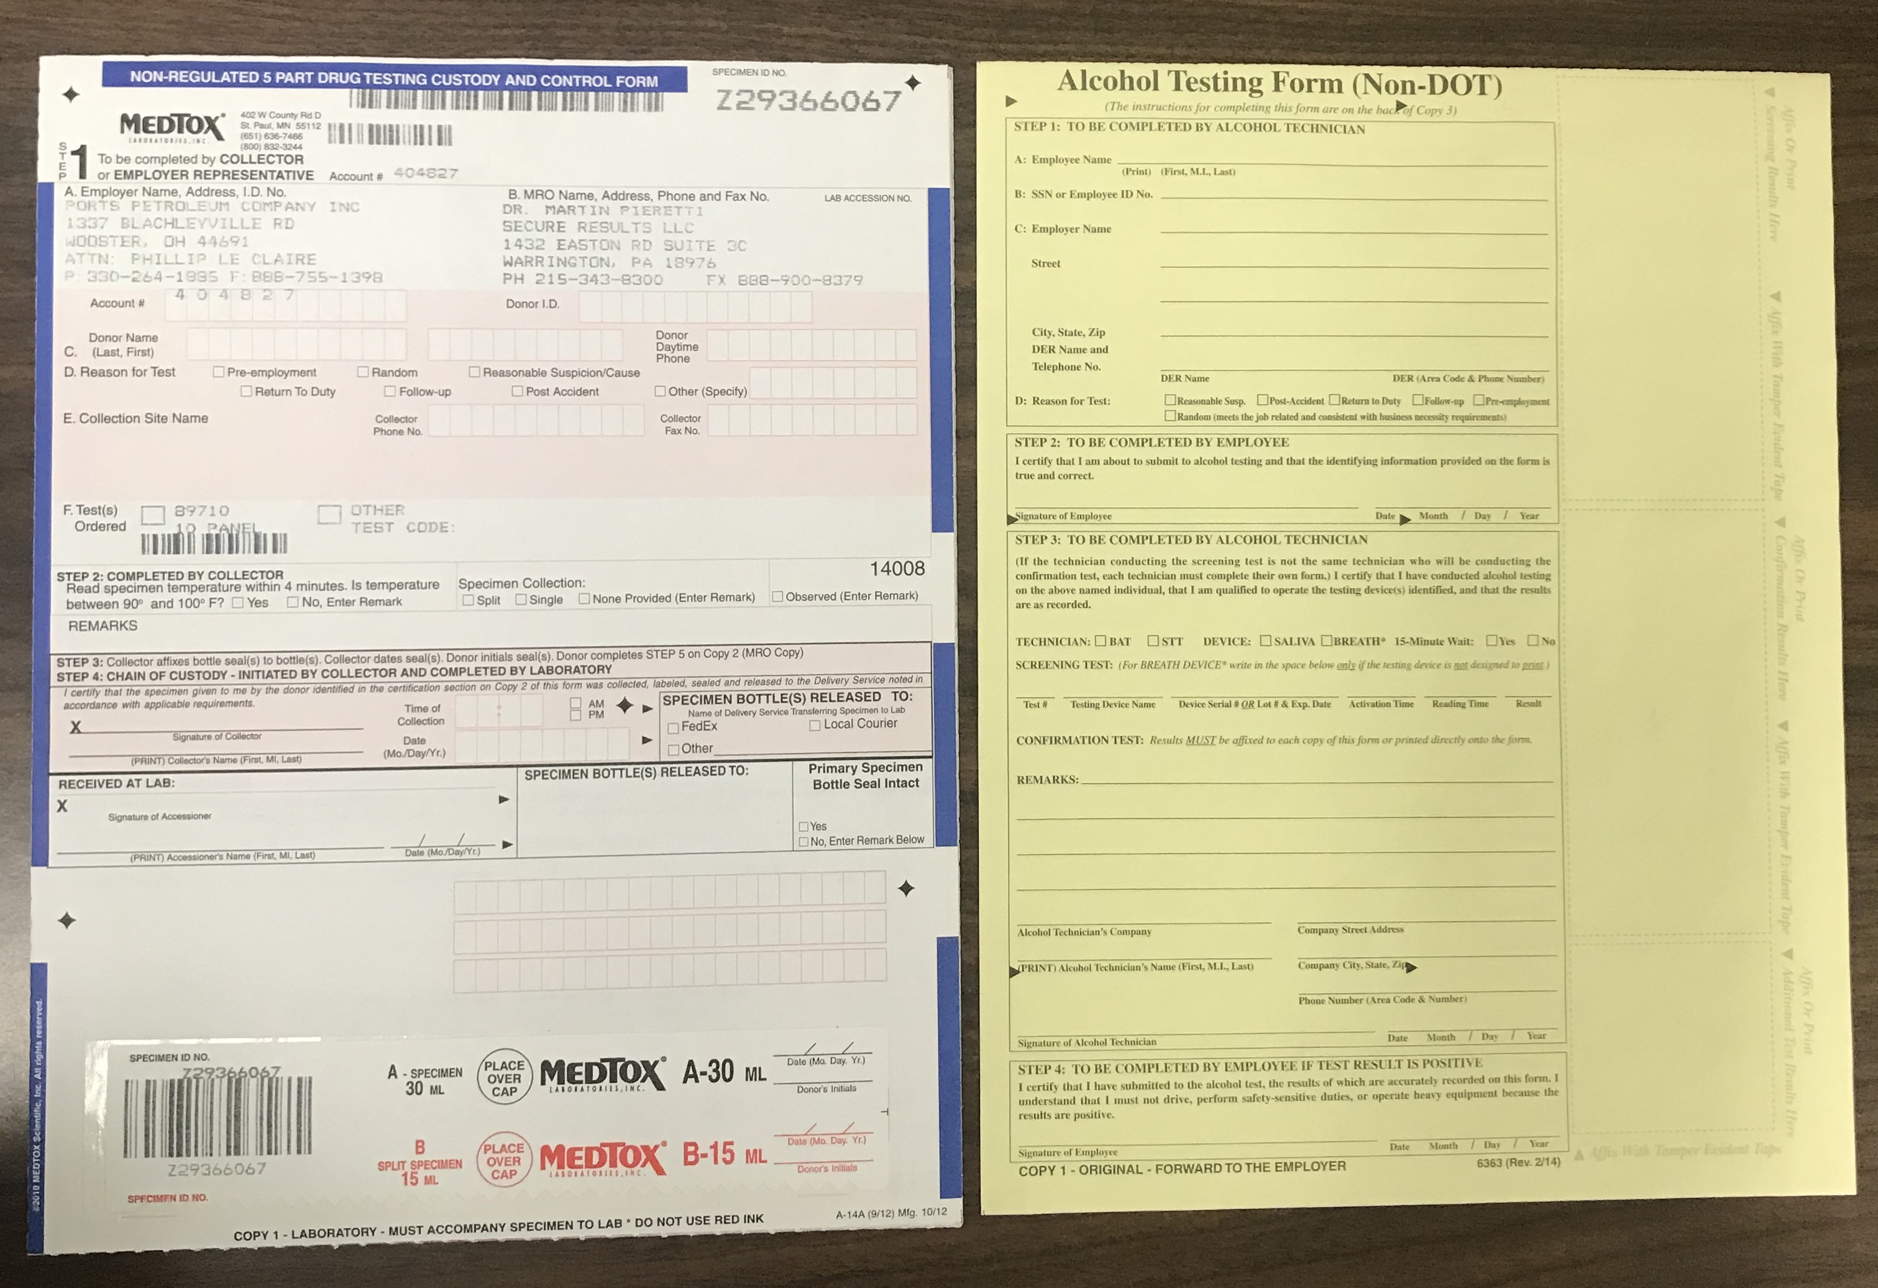
Non Ohio Injury Packet Contents
Revision 3.18.19

Slide 24
Injury packets!!
Do all employees know what injury packets are?
Does your facility have five injury packets?
Are they hanging on the wall?
Are they accessible to all employees at all times (day and night – if your 24/7 operation)?
Does each packet contain all the required paperwork?

Slide 25
WHY Report work related injuries??
Get the employee healthy and back to their normal routines
Potential for reduced employee moral
Loss of productivity not only with the employees involved in the incident but also managers, supervisors and co-workers.
Dissatisfied customers who take their business elsewhere
Corrective measures to prevent future injuries
It’s the right thing to do.

Slide 26
No matter how minor an on-the-job injury may appear, it’s still mandatory to report it.
All injuries occurring in the course of work must be reported.
Handle all employee reported work related injuries as a work-related injury.

Slide 27
If no medical treatment or only first aid treatment is required:
Employee notifies store management
The employee completes the Injury and Illness incident report form.
Witnesses complete a witness statement form.
Notify Pat Conley by scanning and e-mailing the completed paperwork to payroll.
Pat will notify Joel, Phillip and Haley.

Slide 28
If employee seeks or requires medical treatment, the following steps must be completed:
Call Pat Conley (Payroll)
01
Pat C. (primary contact during normal business hours); Phillip L. (secondary & after hours); Joel and Haley.
Employee needs to go to the nearest Urgent Care facility during normal business hours and to the ER for after-hours and emergency situations.
02
Locations are listed on the Fuel Mart documents website.
If you can’t find a medical facility Pat or Phillip can assist.
03

Slide 29
If employee seeks or requires medical treatment, the following steps must be completed:
Provide employee with an Employee Injury packet (i.e. the packet needs to be accessible to all employees – day and night).
01
Employee informs medical facility that it’s a work-related injury.
02
Employee must complete an employee post injury drug screen and breath alcohol test.
03
Employee completes Injury and Illness Report form.
04
Witnesses complete the witness statement form.
05
Scan and send completed forms and medical forms to Pat C. (Payroll).
06

Slide 30
Work related injuries Questions

Slide 31
Incident report form updated

Slide 32
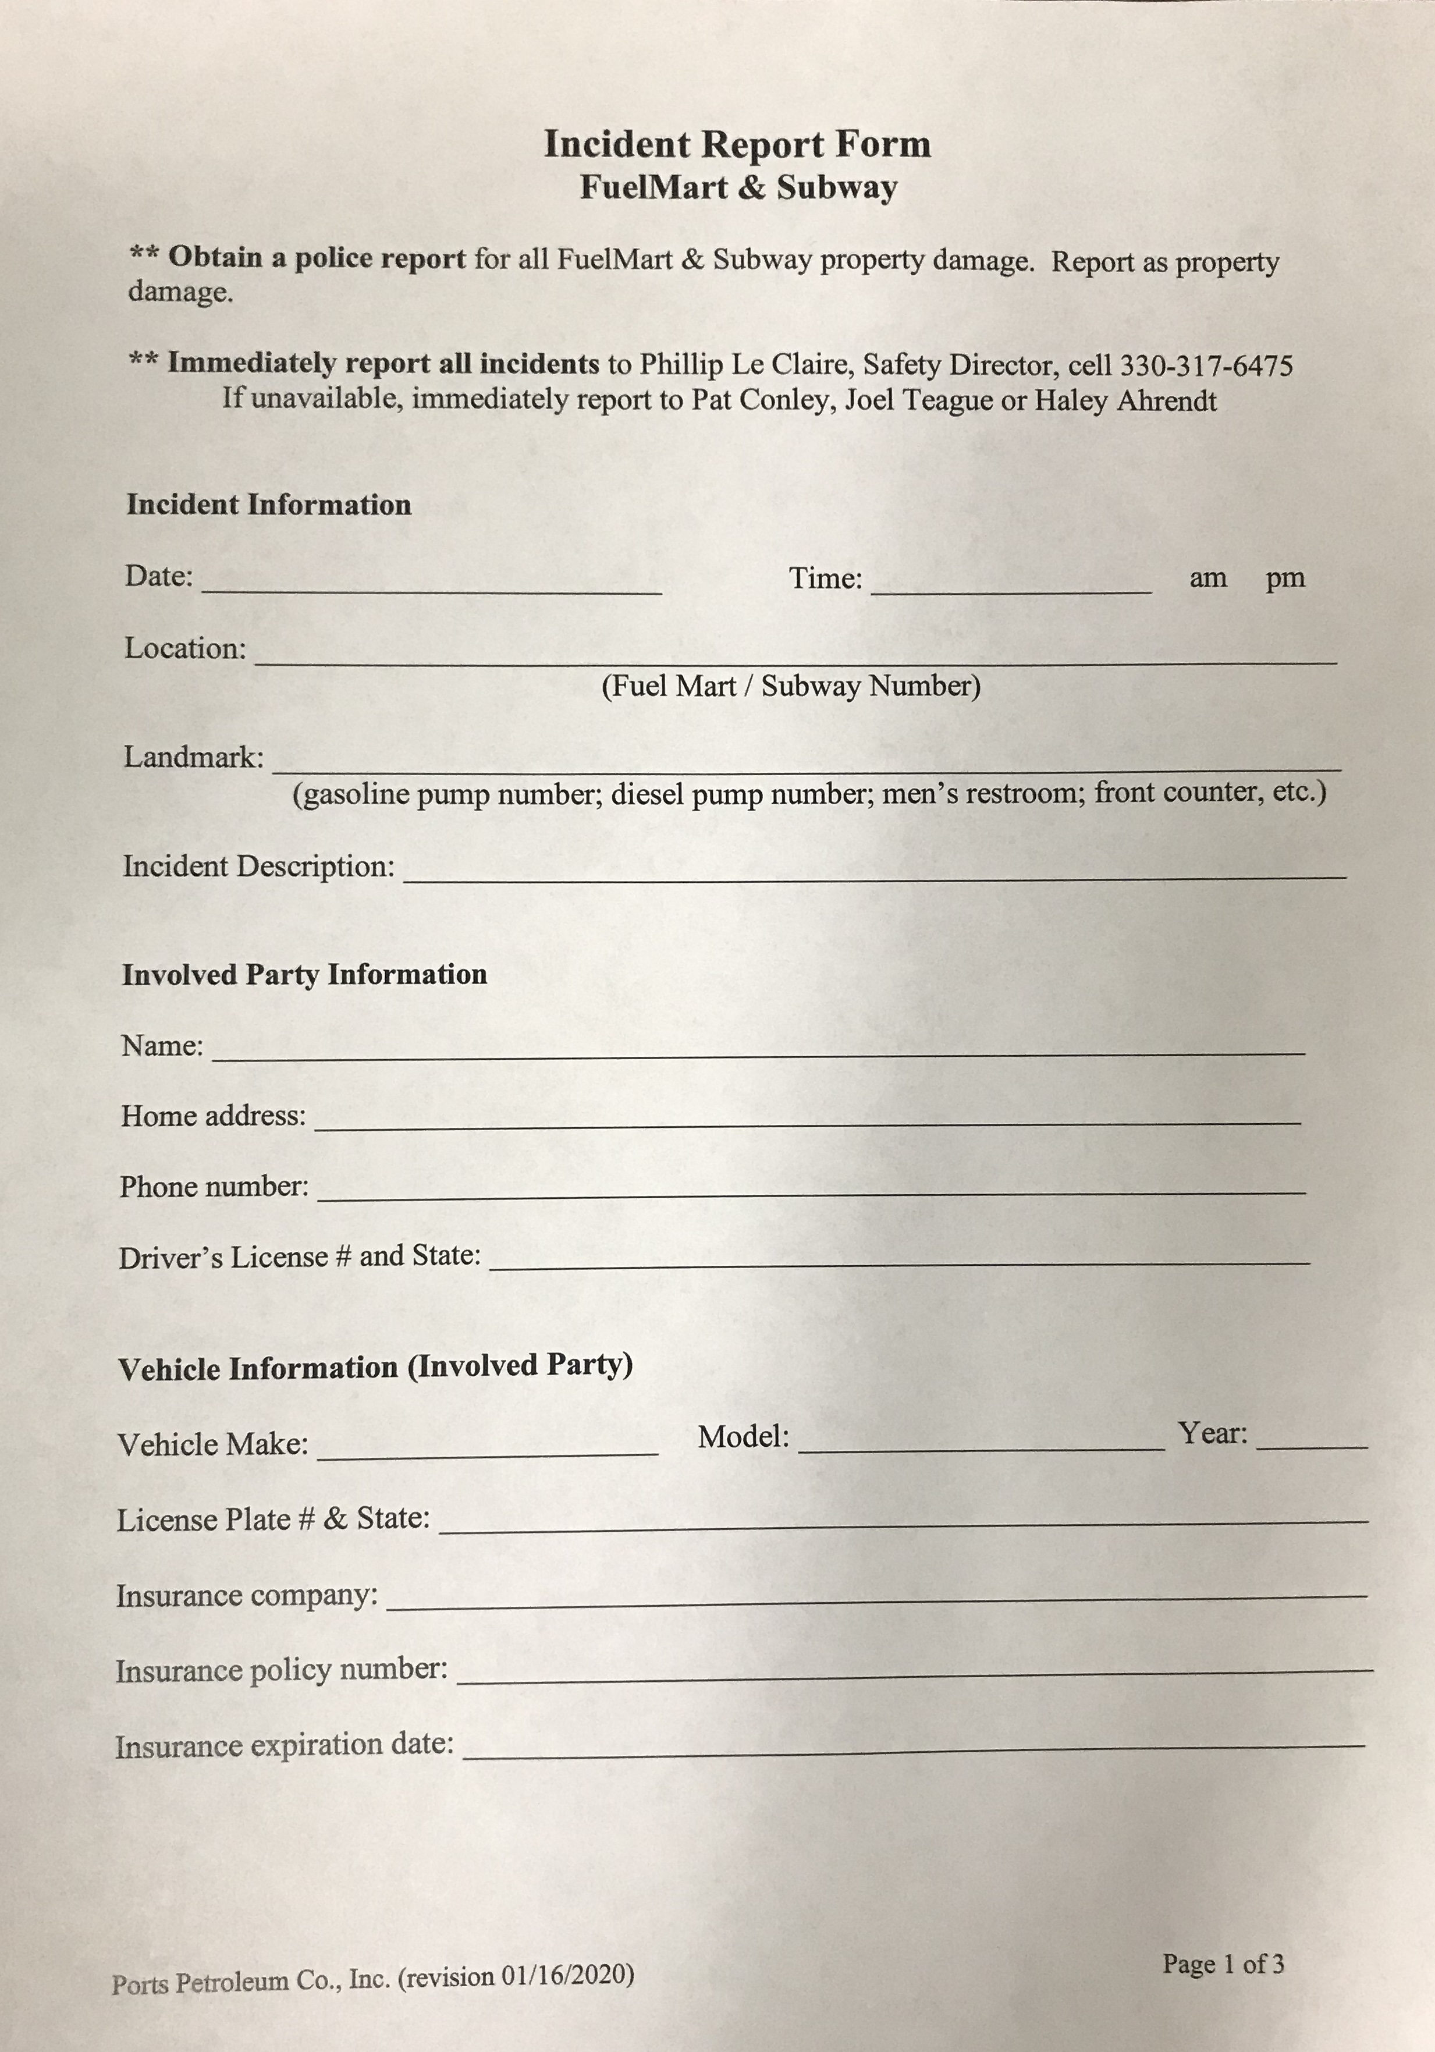
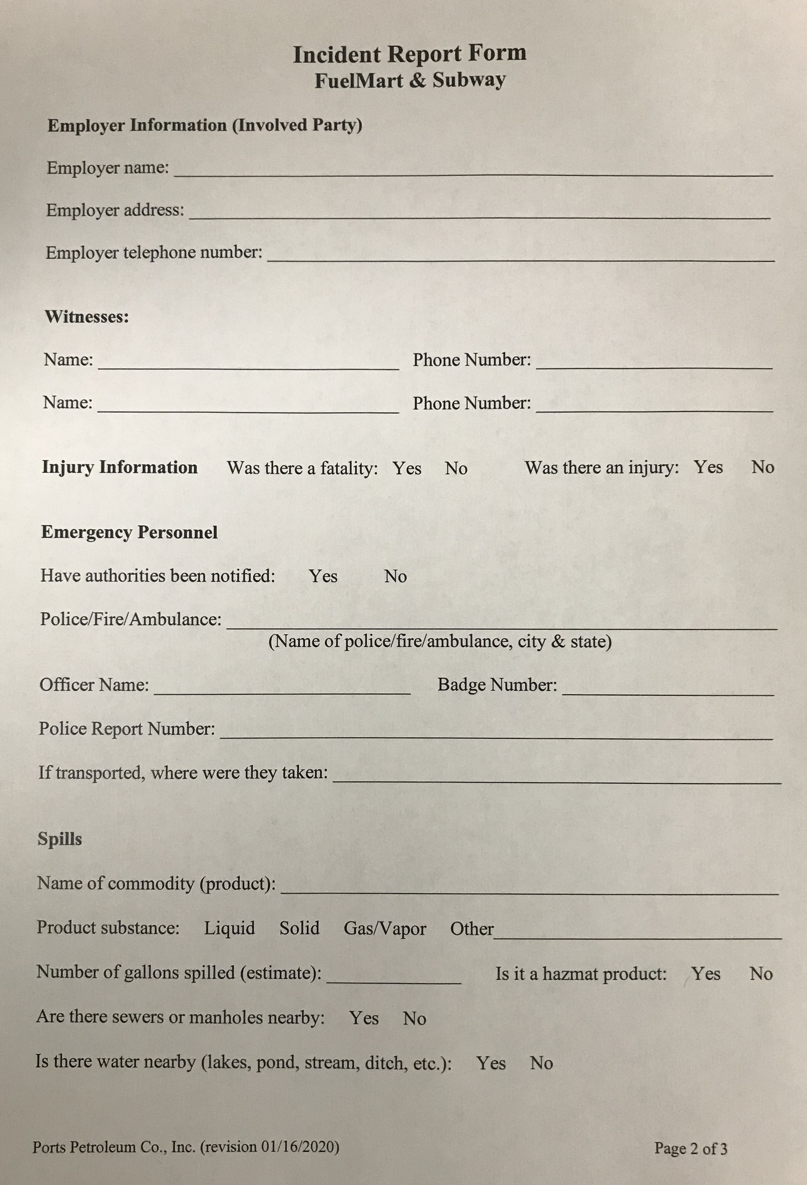

Slide 33
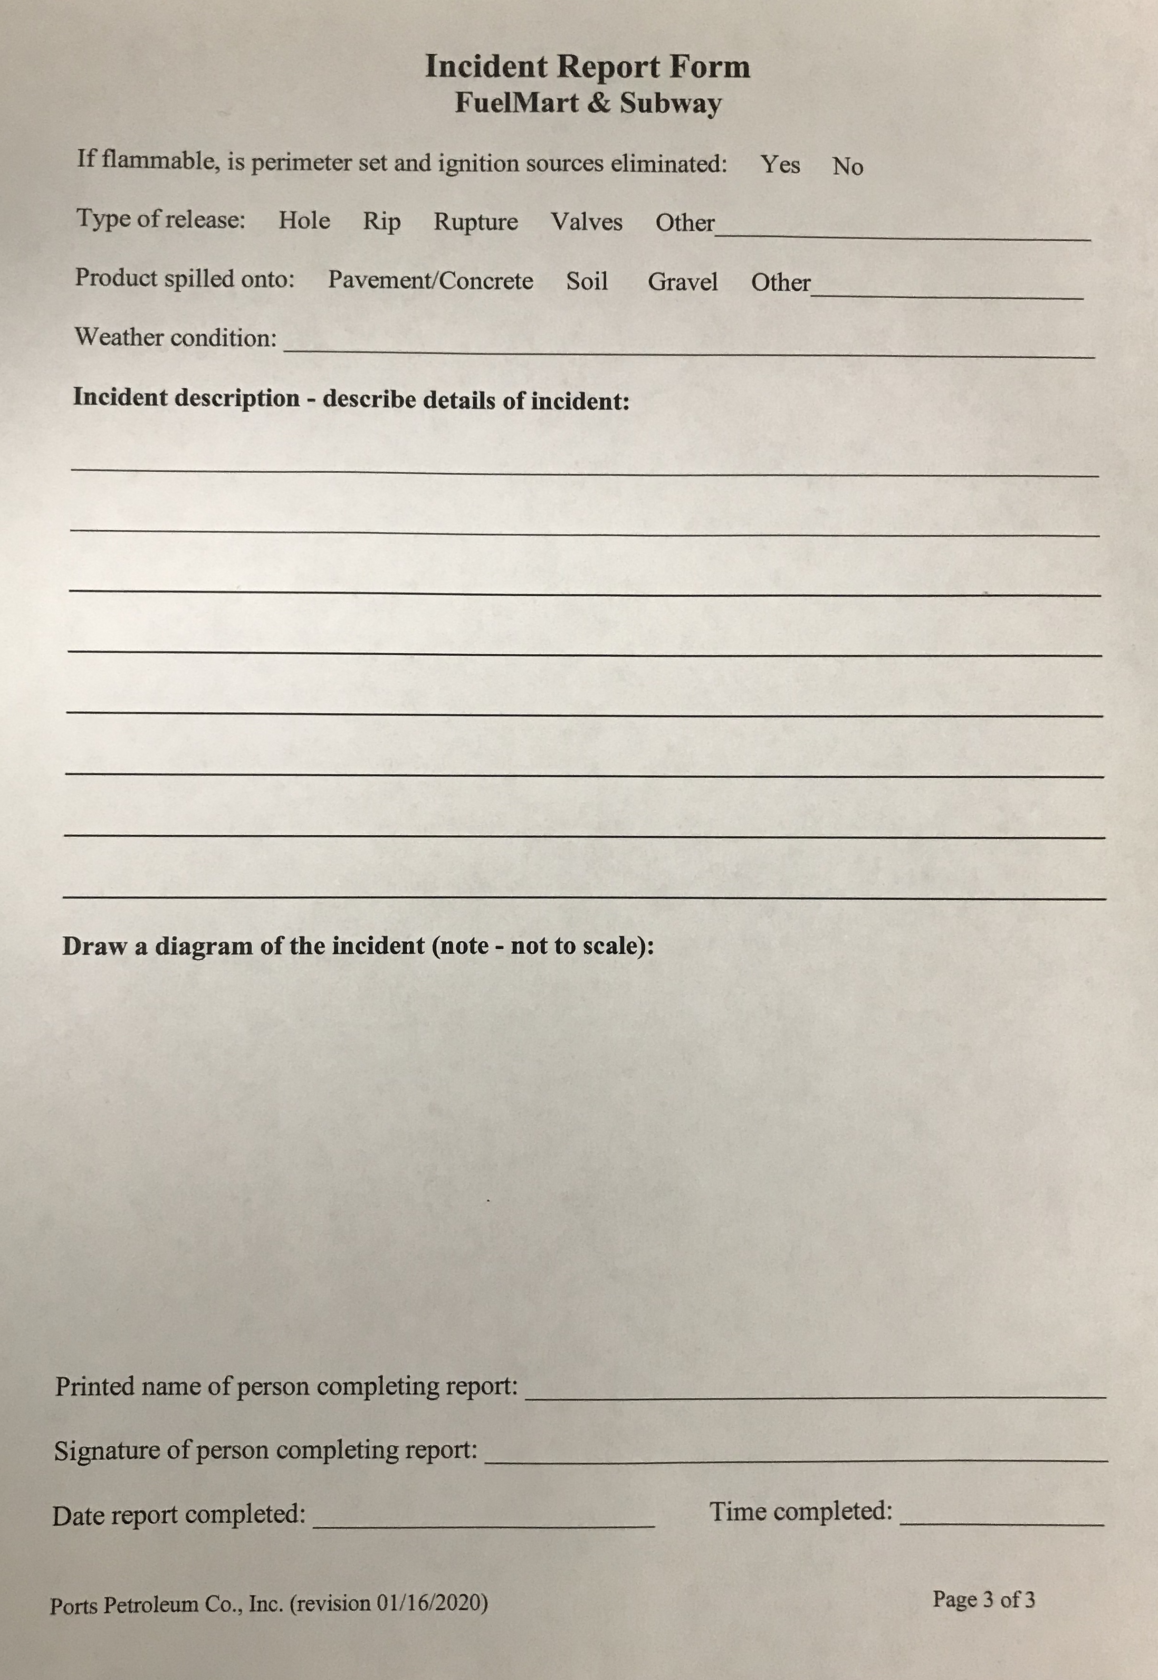

Slide 34
REMINDER:
The Incident Report Form is for Property damage, vehicle, spill and customer incidents
…..BUT NOT for employee work-related injuries.

Slide 35
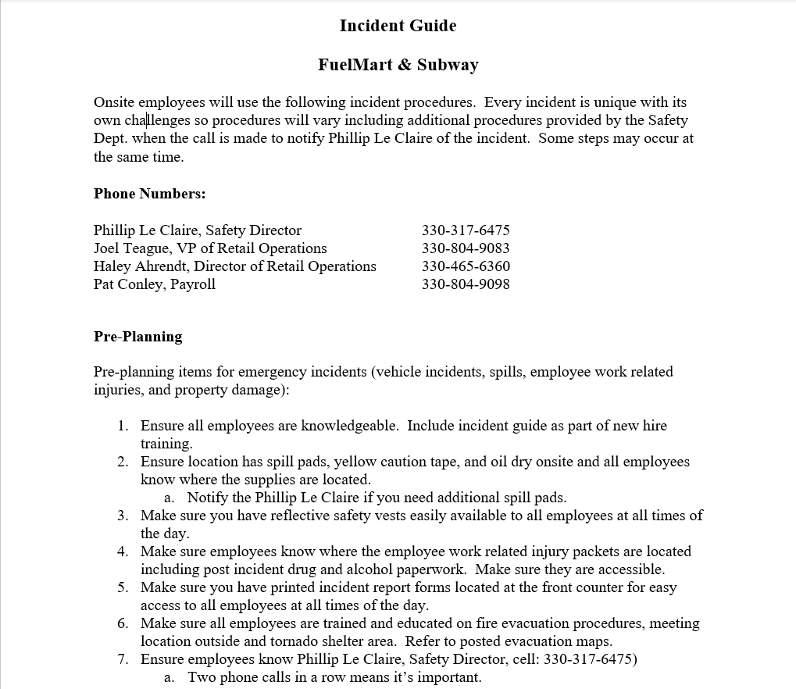

Slide 36
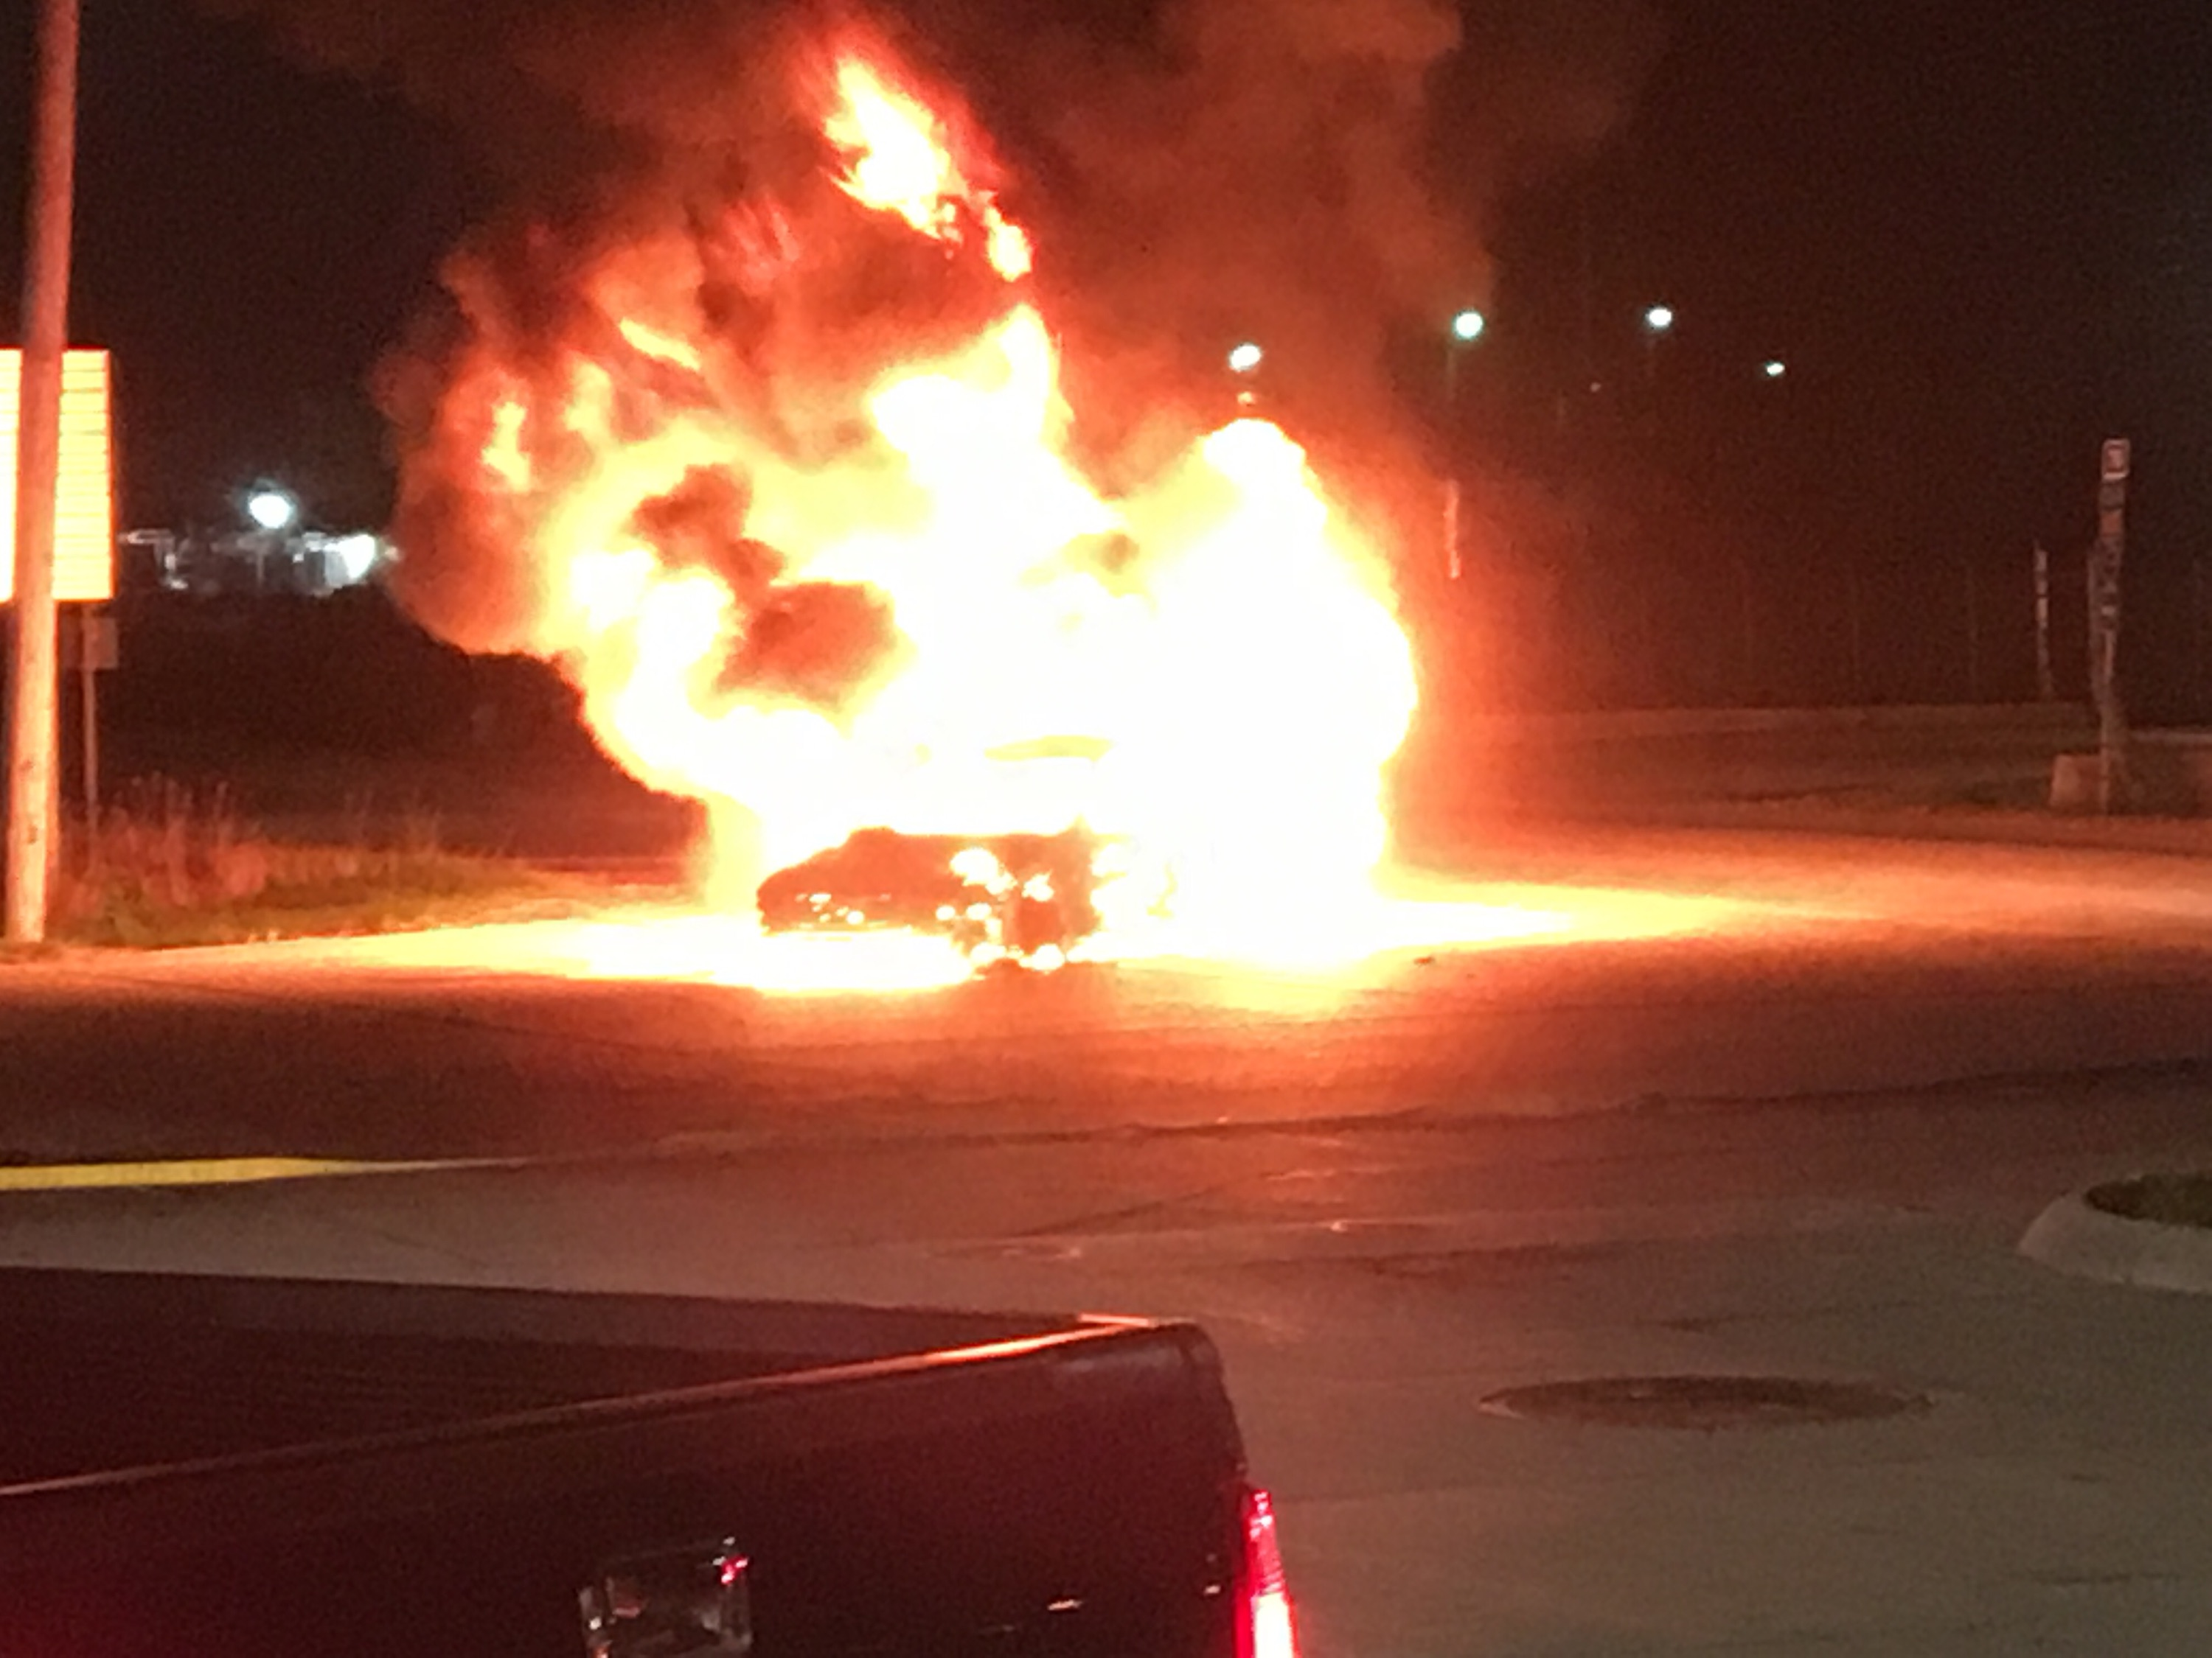
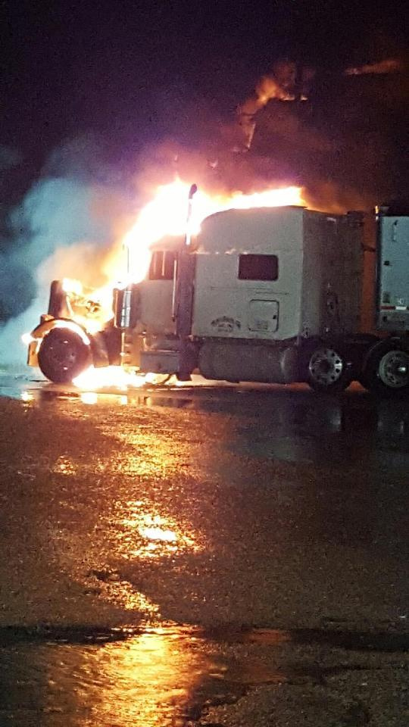
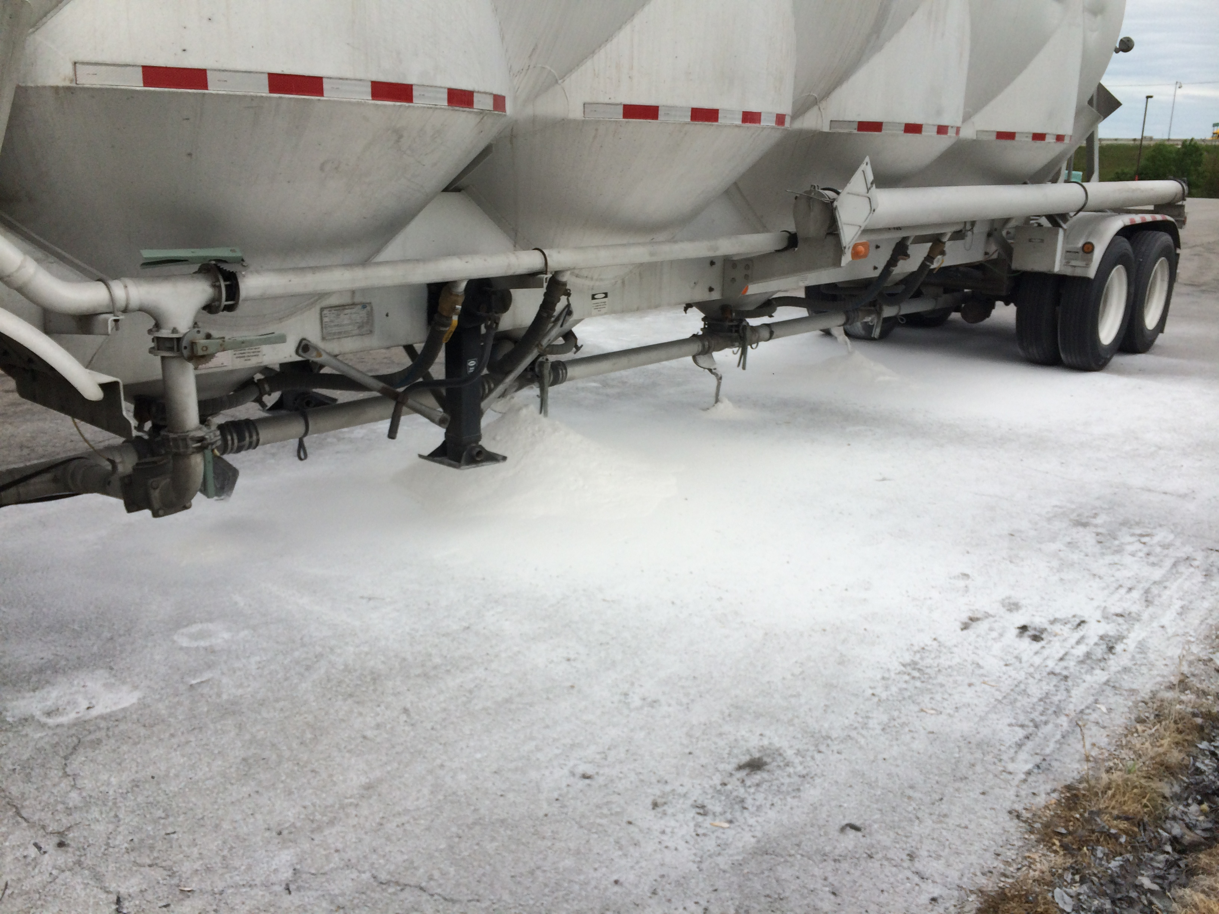
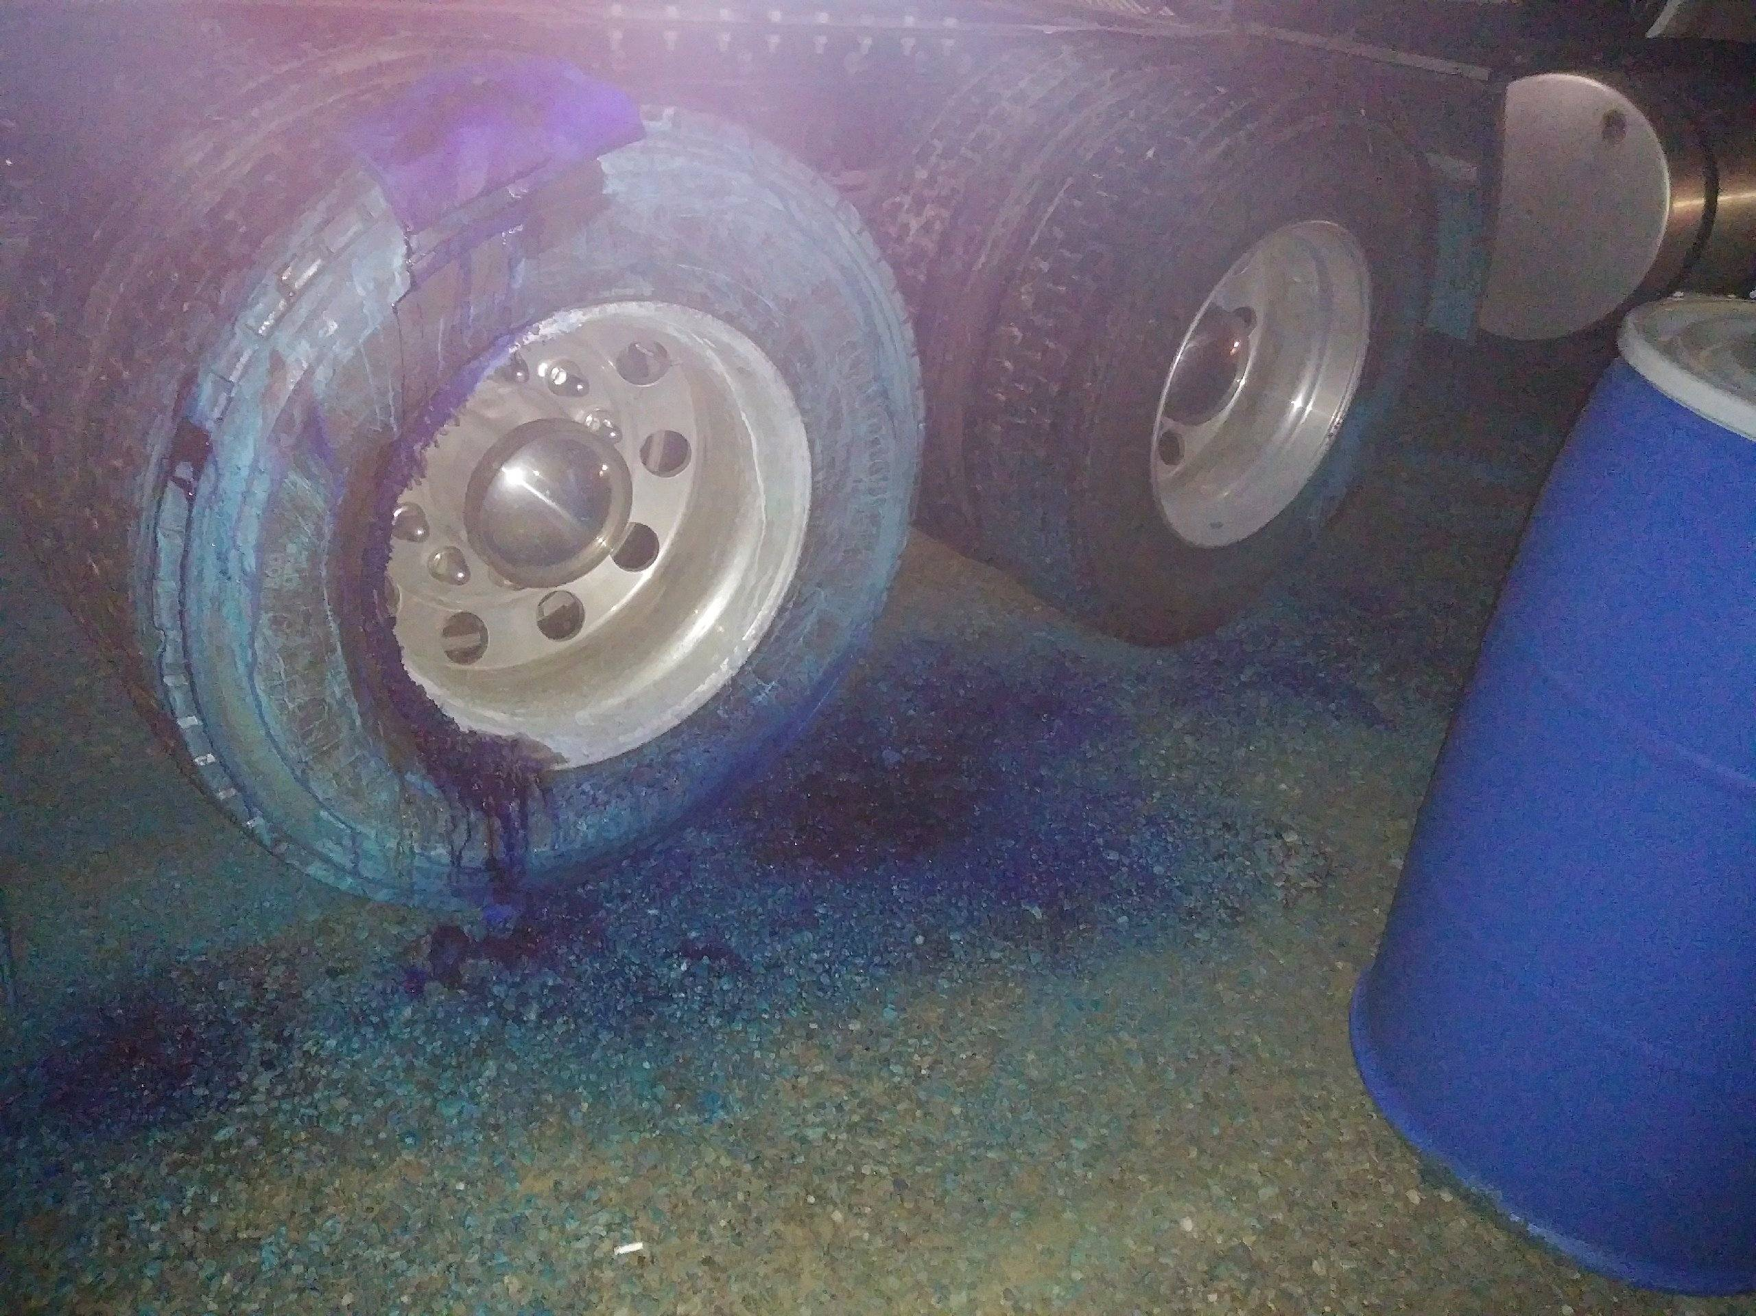
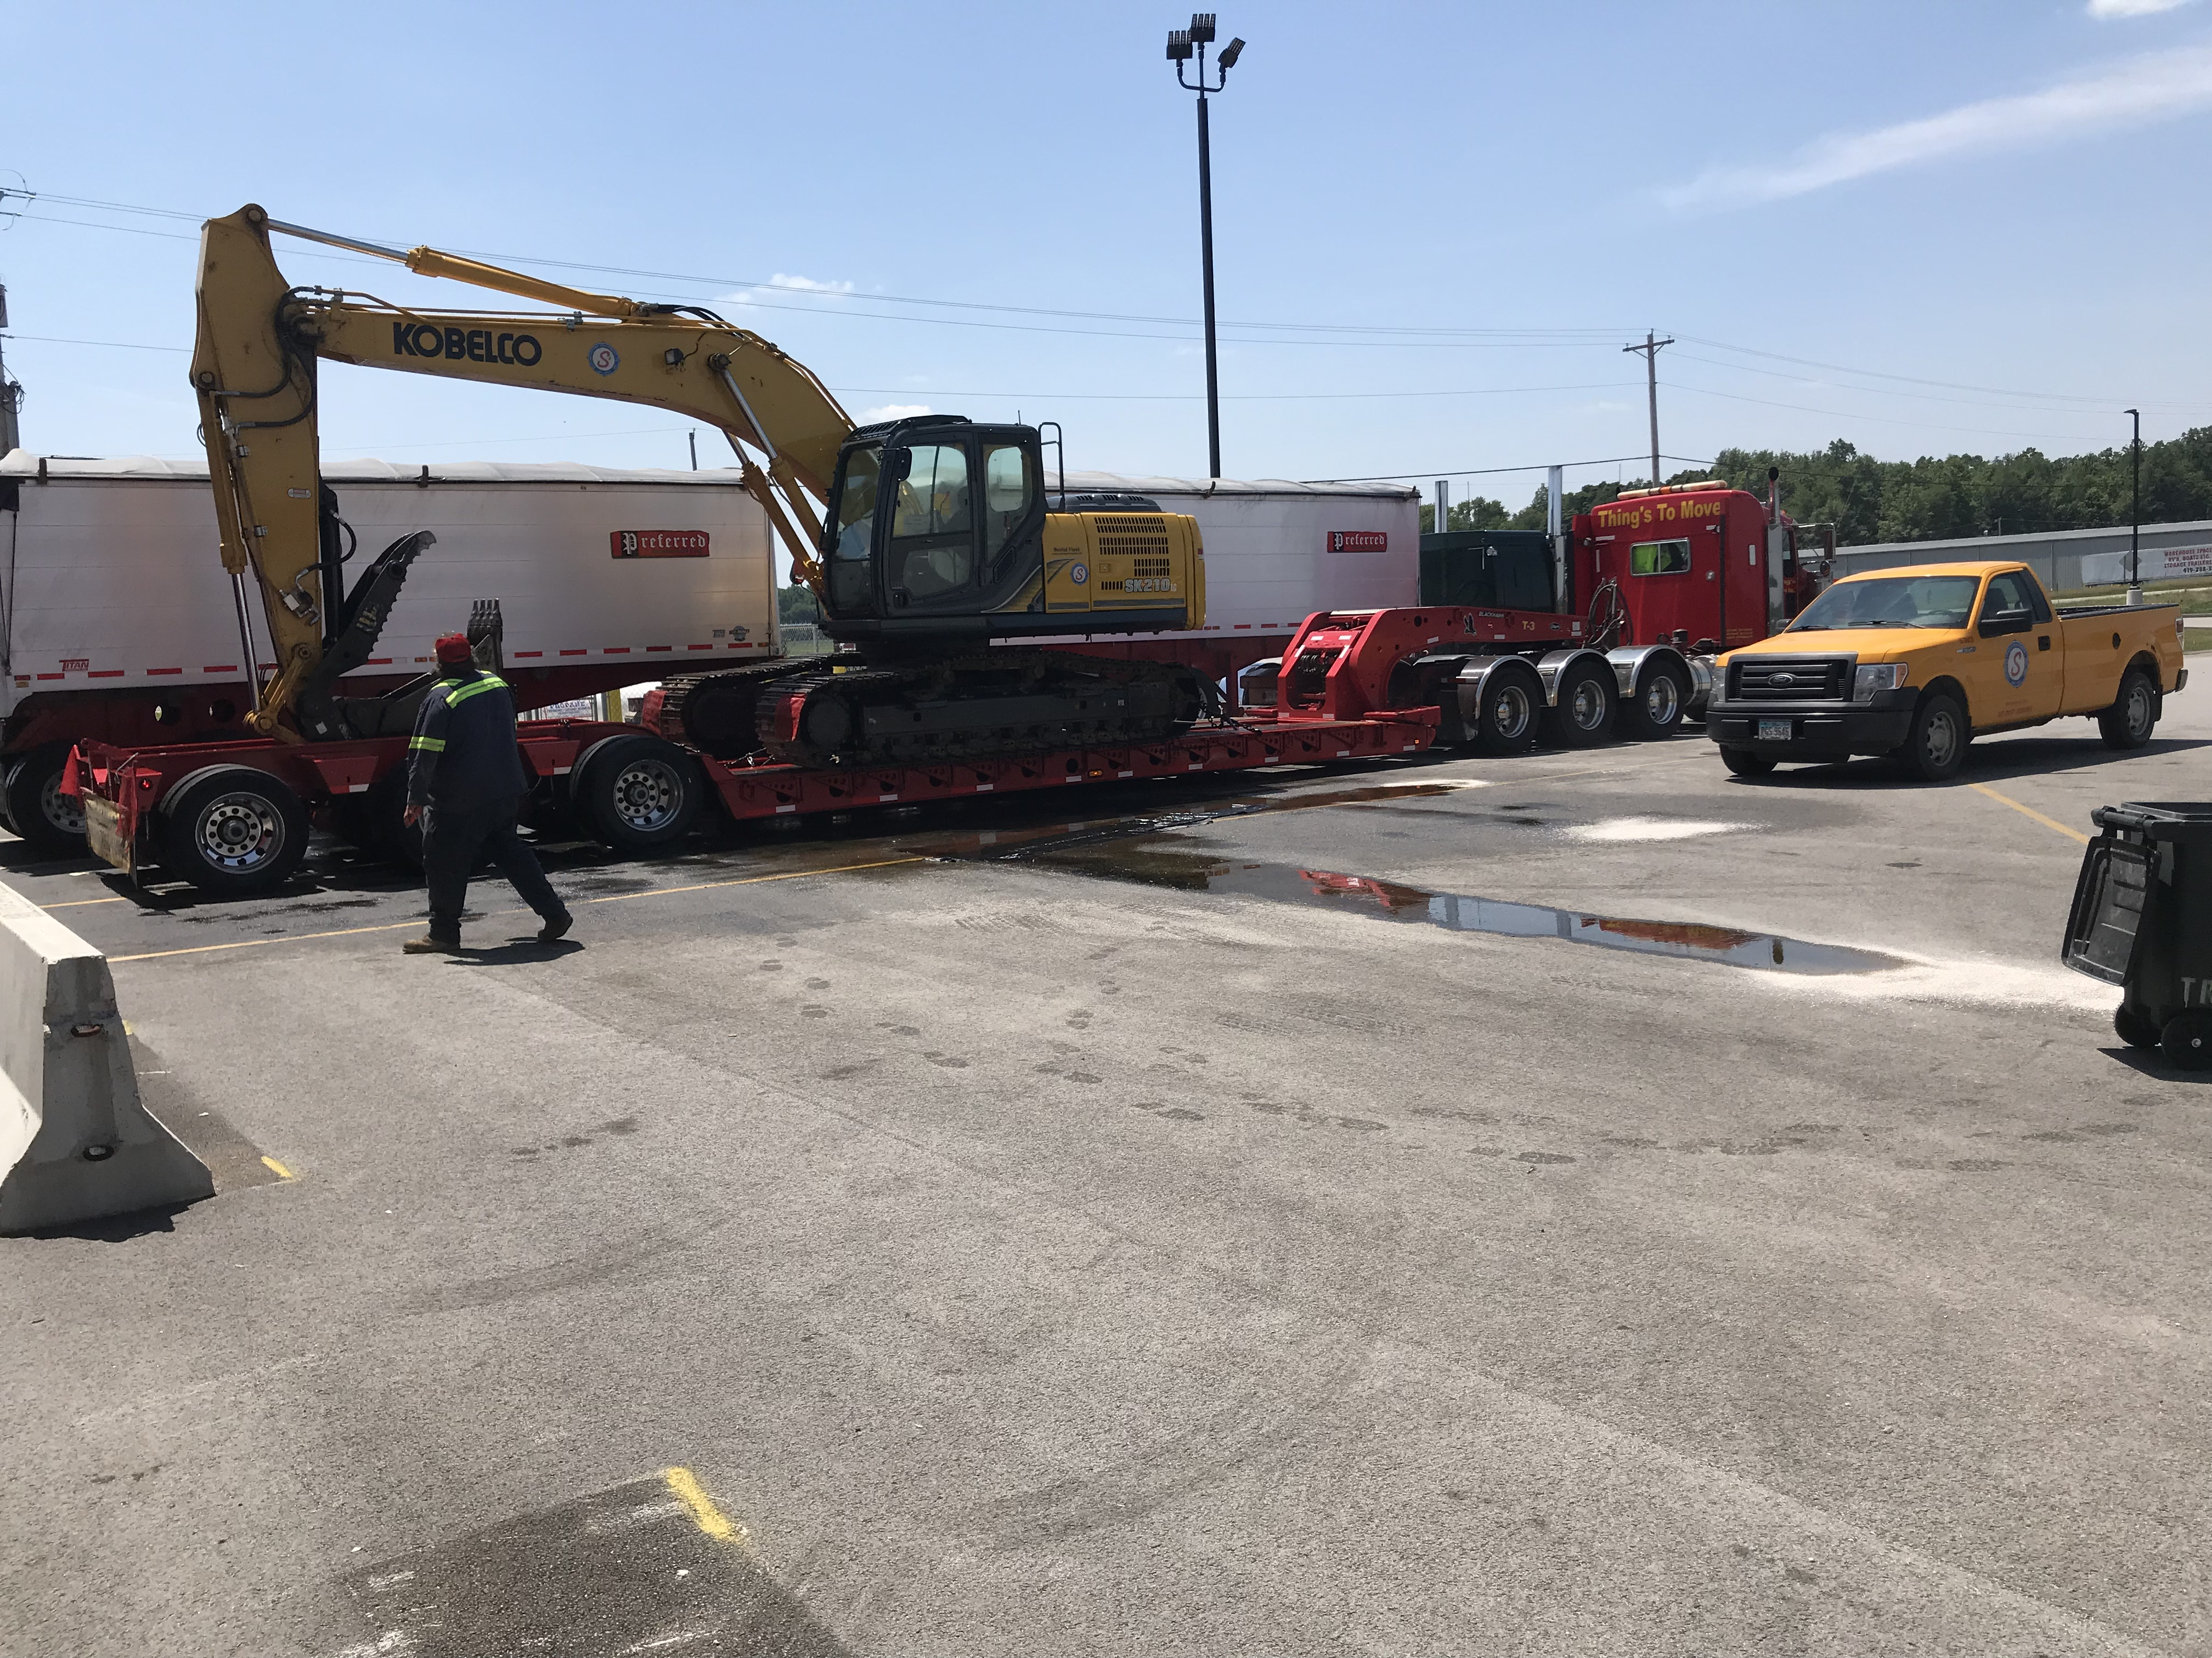
FuelMart 714
FuelMart 641, Silica Sand
FuelMart 764, Corrosive
FuelMart 645
FuelMart 767, hydraulic fluid Spill

Slide 37
Document Reminder
Safety Documents can be found on the FuelMart website at
www.fuelmart.com/docs.php
Incident Forms, Monthly Inspection Forms, Employee Injury Forms
Other documents on the website include
Class C certifications and training
Employment documents (i.e. policies, procedures and forms)
People Matter information
FuelMart handbook
SNAP EBT video
Standard retail policies and procedures

Slide 38
Injury packet review!

Slide 39
Employee Concerns & Suggestions
12.26.19 – FM 626 – Fuel delivery driver indicated there was water in the 87 underground storage tank drop tube spill bucket.

Slide 40
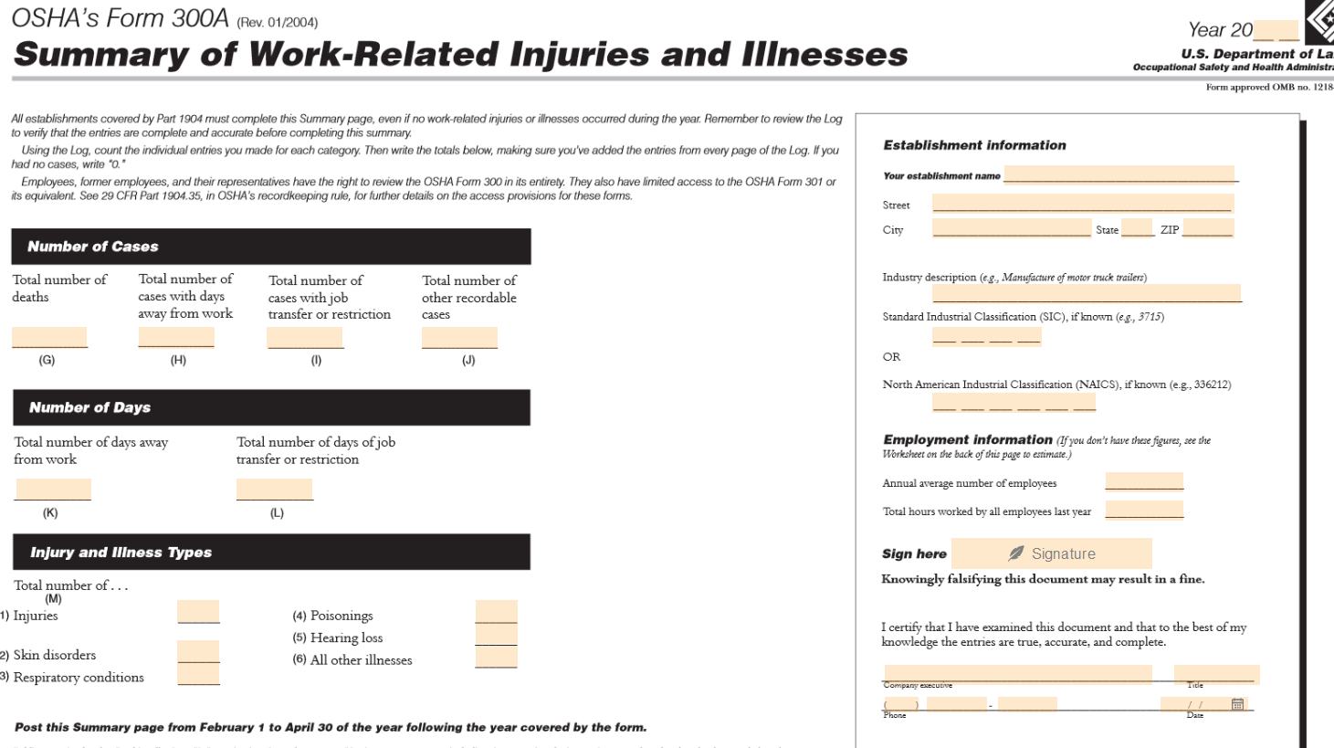
OSHA 300A Form posting – Feb. 01, 2020

Slide 41
Open Floor for Safety concerns & Suggestion
Please remember when filling out your monthly safety inspections to send Lisa Hamilton a separate email or comment in the subject line if there are any missing labels/stickers/signs that need replaced.
Next meeting 2.19.2020
Thank you!

